Slide 1
Build Serverless, Full Stack Applications in Azure SQL (plus IoT!) (and more!)
Sanjay Mishra
Principal Group Program Manager
Microsoft
@SQLCATalyst
Silvano Coriani
Principal Software Engineer
Microsoft
@scoriani
Anna Hoffman
Senior PM Manager
Microsoft
@AnalyticAnna
Davide Mauri
Senior Program Manager
Microsoft
@mauridb
Notes:
Anna, but also to ask Silvano to introduce himself, and also to ask Silvano why we created this module
Link to published module on Learn: https://docs.microsoft.com/en-us/learn/modules/learn-pr/azure/deploy-iot-solution-azure-sql-database/
Schedule for 60 min session:
Intro and overview: 7 min
Intro and architecture: 15 min
Exercise 1: 10 min
Optimize and process: 15 min
Exercise 2: 5 min
Putting it all together: 8 min

Slide 2
Agenda
Keynote, Sanjay Mishra
Deploy IoT solutions with Azure SQL Database
Break
HANDS ON
Build serverless, full stack apps with Azure
Module 1: Azure SQL Database
Break
HANDS ON
Lunch
Build serverless, full stack apps with Azure
Modules 2-4: Functions, Static web apps
HANDS ON
Break
Closing keynote, Sanjay Mishra
Parking lot topics and Q&A
Notes:
Anna

Slide 3
Part 0: Keynote
Sanjay Mishra
Principal Group Program Manager
Microsoft
@SQLCATalyst
Notes:
8:05

Slide 4
Azure SQL DB Our Mission
Empower every byte of data to achieve its full potential

Slide 5
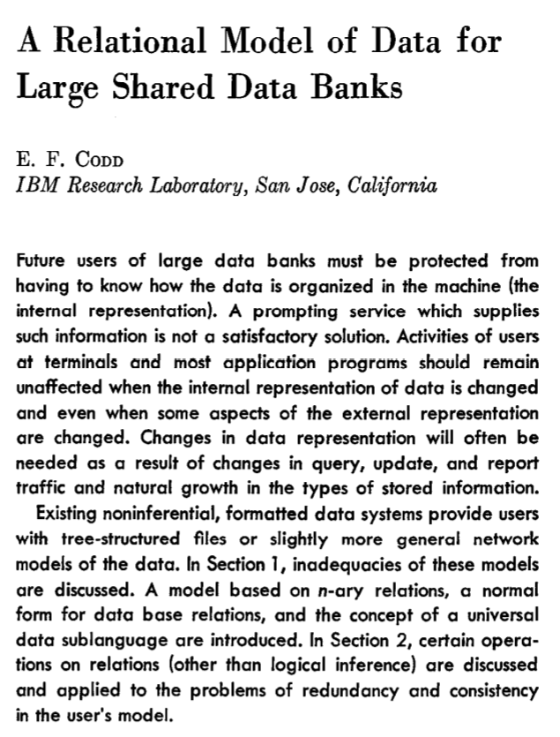
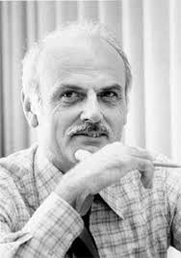
It all began here …
Source: Wikipedia
Communications of the ACM, June 1970, https://doi.org/10.1145/362384.362685

Slide 6
500 M
applications will be created in next five years

Slide 7
90%
of all data in the world created in the last two years

Slide 8
COVID-19 Vaccine
COVID-19 vaccines must be stored in conditions as low as -80°C
Vaccines lose potency when stored in less-than-ideal temperatures
WHO reports ~50% of vaccines around the world are discarded due to non-compliant vaccine storage and monitoring
The risk of administering an ineffective vaccination can be detrimental to public safety and facility credibility
Vaccine temperature monitoring system (a device, plus an application built on Azure SQL DB) ensures seamless vaccine storage monitoring and send immediate alert notifications the moment readings fall outside range
All data is time-stamped and recorded, ensuring vaccine temperature compliance and visibility

Slide 9

CryptoBLK
Startup based in Hong Kong
Builds blockchain applications for banking and insurance industry
Currently building a software for a consortium of 8 biggest banks in Hong Kong
Builds application in R3 Corda
H2 is the default database that comes with R3 Corda
They replaced H2 with Azure SQL DB.
They needed high-end security features in SQL DB (TDE, Always Encrypted)

Slide 10
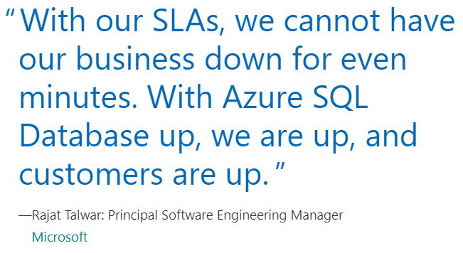
Microsoft Dynamics 365
The most prominent enterprises in the world, including Fortune 500 companies, rely on Microsoft Dynamics 365 as the business software that powers enterprise resource planning and customer relationship management. Microsoft Dynamics 365 runs on Azure SQL and uses over
1,000,000 Azure SQL databases

Slide 11

Data is the new Oxygen
And, you, the developers, are the plants of this Data World, producing Oxygen.

Slide 12
Part 1: Deploy IoT solutions with Azure SQL Database
Silvano Coriani
Principal Software Engineer
Microsoft
@scoriani
Anna Hoffman
Senior PM Manager
Microsoft
@AnalyticAnna
Notes:
8:35
Anna, but also to ask Silvano to introduce himself, and also to ask Silvano why we created this module
Link to published module on Learn: https://docs.microsoft.com/en-us/learn/modules/learn-pr/azure/deploy-iot-solution-azure-sql-database/
Schedule for 60 min session:
Intro and overview: 7 min
Intro and architecture: 15 min
Exercise 1: 10 min
Optimize and process: 15 min
Exercise 2: 5 min
Putting it all together: 8 min

Slide 13
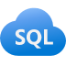

Learning objectives
Create scalable IoT solutions using Azure SQL Database
Use the template provided for many IoT use cases.
Notes:
Anna

Slide 14

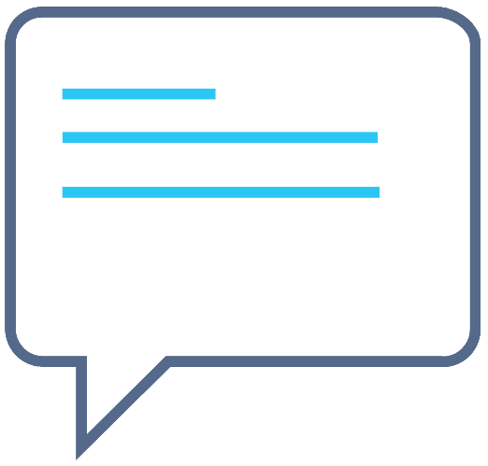


Live & interactive
Say “hi” and ask questions in the chat
Notes:
As a reminder this is a live interactive session, so please make sure you head over to chat say ‘hi’ and ask any questions you might have as we go through the material.
We will answer questions as we go through, but even if we don’t get to them we have a team of moderators who are subject matter experts who will be answering questions in the chat also.

Slide 15
Introduction
Notes:
Anna
Many organizations are investing in IoT to increase operational efficiency, deliver better customer experiences, increase levels of security, enhance workplace safety, and reduce costs. Azure SQL Database provides a price-performant backend, including templates that simplify deploying and configuring IoT solutions for any scenario.
Suppose you work for a distributor and your role is to manage the logistics of shipping goods between the main warehouses. These goods are shipped via a fleet of several thousand trucks. Because of the distance between the warehouses, sometimes a truck can drive 2-3 days without stopping at a warehouse. It is your responsibility to make sure the trucks show up on time. One key consideration is the maintenance of the trucks. At the main warehouses, there is a dedicated team for addressing any issues or maintenance with the truck. If a truck breaks down or needs unexpected maintenance when it is scheduled to be driven or is not at a main warehouse, significant delays and expenses follow. You want to implement a system that uses IoT devices to monitor the health of your fleet. Because of the size of the fleet, you need a system that can ingest thousands of entries per second, have unlimited storage, and help you do preventative maintenance to prevent delays and extra expenses.
In this module, you'll deploy a baseline IoT solution that uses Azure SQL Database Hyperscale as the backend database. First, you'll analyze the solution architecture and how it can be used for IoT solutions. Next, you'll deploy the solution template and configure the device simulator. Finally, you'll implement, monitor, and react to a workload, using tools like Azure Functions, Azure IoT Hub, and dashboards.
By the end of the module, you'll be able to use the template provided to create scalable IoT solutions and apply it to various IoT use cases.

Slide 16

Scenario
Implement a system that uses IoT devices to monitor the health of your shipping fleet
Notes:
Anna
Suppose you work for a distributor and your role is to manage the logistics of shipping goods between the main warehouses. These goods are shipped via a fleet of several thousand trucks. Because of the distance between the warehouses, sometimes a truck can drive 2-3 days without stopping at a warehouse. It is your responsibility to make sure the trucks show up on time. One key consideration is the maintenance of the trucks. At the main warehouses, there is a dedicated team for addressing any issues or maintenance with the truck. If a truck breaks down or needs unexpected maintenance when it is scheduled to be driven or is not at a main warehouse, significant delays and expenses follow. You want to implement a system that uses IoT devices to monitor the health of your fleet. Because of the size of the fleet, you need a system that can ingest thousands of entries per second, have unlimited storage, and help you do preventative maintenance to prevent delays and extra expenses.

Slide 17
Scenario
Suppose you work for a distributor and your role is to manage the logistics of shipping goods between the main warehouses. These goods are shipped via a fleet of several thousand trucks. Because of the distance between the warehouses, sometimes a truck can drive 2-3 days without stopping at a warehouse. It is your responsibility to make sure the trucks show up on time. One key consideration is the maintenance of the trucks. At the main warehouses, there is a dedicated team for addressing any issues or maintenance with the truck. If a truck breaks down or needs unexpected maintenance when it is scheduled to be driven or is not at a main warehouse, significant delays and expenses follow. You want to implement a system that uses IoT devices to monitor the health of your fleet. Because of the size of the fleet, you need a system that can ingest thousands of entries per second, have unlimited storage, and help you do preventative maintenance to prevent delays and extra expenses.
Notes:
Anna

Slide 18
Analyze the solution architecture
Notes:
Anna to ask Silvano about a typical IoT solution architecture
IoT solutions usually include several components that span from device communication and management to event processing, data ingestion, and analysis. Deploying all these components independently on compute, network, and storage-based infrastructures can be a complex and time consuming task. Even more challenging is managing, monitoring, and operating these systems at significant scale.
Recall in the distributor example, there are thousands of trucks that you're hoping to monitor the health and status of. Each truck will need to have a connected IoT device that is sending telemetry data to be processed, stored, and analyzed.
Here, you will learn about the canonical IoT architecture, how Azure SQL Database can support the architecture, and a template you can use for any IoT scenario.

Slide 19
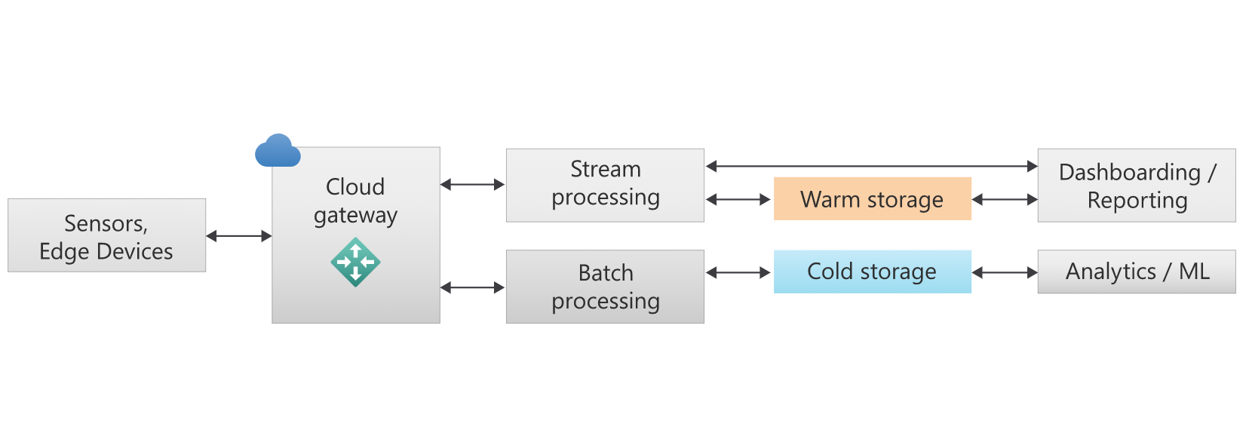
Typical IoT solutions
Notes:
Silvano
A typical IoT solution typically has the following components:
Let's identify and describe the roles and responsibilities of each of these components:
Individual edge devices: From intelligent sensors to industrial PCs aggregating multiple signals, these devices send telemetry messages and receive commands from the cloud.
Cloud gateway: Manage bi-directional communications with devices, like queueing events and messages. They are also used for device provisioning and management.
Stream processing: Perform real-time streaming for capturing low latency events like alarms and thresholds to be plotted on a dashboard. Event processing can also perform batch processing and storing for large amounts of data for future analysis.
Warm storage: Persist low latency events and messages that need to be ingested efficiently and at a high rate. At the same time, warm storage needs to be able to be queried concurrently by a combination of point lookup and aggregated queries.
Cold storage: Retain raw, original messages that can be further processed and curated with big data and analytical engines to extract insights. Cold storage should be optimized for large data volumes at a reasonable cost.
Dashboarding / Reporting: This real-time analysis is mostly comparing trends and values over time and is referred to often as hybrid transactional/analytical processing (HTAP).
Analytics / ML: Perform additional analytics and even machine learning to build models with actionable insights.
Fortunately, the Azure platform offers a full portfolio of platform-as-a-service (PaaS) services that integrate seamlessly and cover all the needs of modern, scalable IoT solutions. A sample architecture shows a selection of services available.
For device connectivity and management, IoT Hub (1) provides secure and reliable communication for your (IoT) applications, connecting virtually any device and offering comprehensive per-device authentication options, built-in device management, predictable performance and availability. IoT Hub, which is built on Azure Event Hub (event store), can process and manage millions of events per second, with easy consumption through APIs and several Azure services.
Azure Stream Analytics (2), as an example, is a real-time analytics service designed for mission-critical workloads to build end-to-end, serverless streaming pipelines with just a few clicks. With Azure Stream Analytics, your IoT solution can analyze and react in real time to specific event patterns or thresholds generated by your device fleet, and be used to populate dashboard and reports capturing low-latency phenomenon in the system.
To process the remaining amount of all the events generated by devices that need to be captured, stored, and analyzed, you can use another PaaS service like Azure Functions (3), an event-driven, serverless compute platform that natively connects to the IoT Hub event store. Azure Functions can consume batches of incoming messages and process them following your customizable logic written in one of the many programming languages supported.
Other services within the Azure platform can be plugged-in with minimum effort; a great example is Azure Logic Apps (4). Azure Logic Apps can help you automate critical workflows without writing a single line of code, by providing a myriad of out-of-the-box connectors to other services and the ability to graphically design complex process that can be used in areas like data integration, management, or orchestration. Actions like triggering a dataset refresh in Power BI when certain events are happening at the database level become simple and intuitive to implement with Logic Apps. Another example is Azure Machine Learning (5), which can be used to create and train complex machine learning models using the IoT data.
Azure SQL (including SQL Server on Azure VM, Azure SQL Managed Instance, and Azure SQL Database) (6) is a great choice to address the warm storage requirements, and Azure SQL has great integrations with the aforementioned Azure services:
Stream processing results from Azure Stream Analytics can be persisted directly in Azure SQL's disk-based or in-memory optimized tables for low latency and high throughput, to be then queried and analyzed. Azure Stream Analytics uses a SQL dialect, extensible with custom code, which covers the most advanced scenarios, and can scale up and down to cover the most challenging workloads.
Azure Functions can be bound to the incoming message flow that will trigger processing on one end, and can use Azure SQL client libraries on the other end to define data shape and form before persisting what's needed in a relational or non-relational format in the database.
Azure Logic Apps contains several connectors for Azure SQL, which include triggers and actions based on incoming events.
Azure Machine Learning can easily use the data stored in Azure SQL to create and train models.

Slide 20
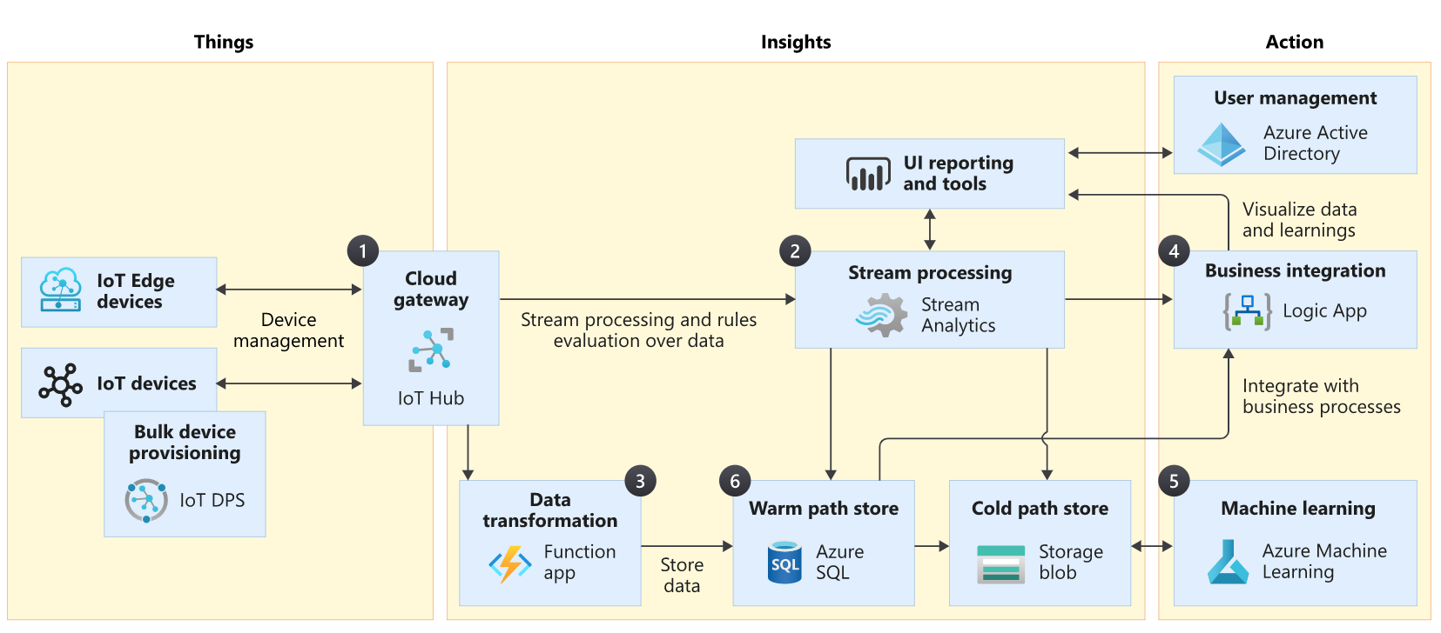
Construct IoT solutions with Azure
Notes:
Silvano
Fortunately, the Azure platform offers a full portfolio of platform-as-a-service (PaaS) services that integrate seamlessly and cover all the needs of modern, scalable IoT solutions. A sample architecture shows a selection of services available.
For device connectivity and management, IoT Hub (1) provides secure and reliable communication for your (IoT) applications, connecting virtually any device and offering comprehensive per-device authentication options, built-in device management, predictable performance and availability. IoT Hub, which is built on Azure Event Hub (event store), can process and manage millions of events per second, with easy consumption through APIs and several Azure services.
Azure Stream Analytics (2), as an example, is a real-time analytics service designed for mission-critical workloads to build end-to-end, serverless streaming pipelines with just a few clicks. With Azure Stream Analytics, your IoT solution can analyze and react in real time to specific event patterns or thresholds generated by your device fleet, and be used to populate dashboard and reports capturing low-latency phenomenon in the system.
To process the remaining amount of all the events generated by devices that need to be captured, stored, and analyzed, you can use another PaaS service like Azure Functions (3), an event-driven, serverless compute platform that natively connects to the IoT Hub event store. Azure Functions can consume batches of incoming messages and process them following your customizable logic written in one of the many programming languages supported.
Other services within the Azure platform can be plugged-in with minimum effort; a great example is Azure Logic Apps (4). Azure Logic Apps can help you automate critical workflows without writing a single line of code, by providing a myriad of out-of-the-box connectors to other services and the ability to graphically design complex process that can be used in areas like data integration, management, or orchestration. Actions like triggering a dataset refresh in Power BI when certain events are happening at the database level become simple and intuitive to implement with Logic Apps. Another example is Azure Machine Learning (5), which can be used to create and train complex machine learning models using the IoT data.
Azure SQL (including SQL Server on Azure VM, Azure SQL Managed Instance, and Azure SQL Database) (6) is a great choice to address the warm storage requirements, and Azure SQL has great integrations with the aforementioned Azure services:
Stream processing results from Azure Stream Analytics can be persisted directly in Azure SQL's disk-based or in-memory optimized tables for low latency and high throughput, to be then queried and analyzed. Azure Stream Analytics uses a SQL dialect, extensible with custom code, which covers the most advanced scenarios, and can scale up and down to cover the most challenging workloads.
Azure Functions can be bound to the incoming message flow that will trigger processing on one end, and can use Azure SQL client libraries on the other end to define data shape and form before persisting what's needed in a relational or non-relational format in the database.
Azure Logic Apps contains several connectors for Azure SQL, which include triggers and actions based on incoming events.
Azure Machine Learning can easily use the data stored in Azure SQL to create and train models.

Slide 21

Achieve IoT scale with Azure SQL Database
Up to 128 vCores (M-Series hardware) or 100 TB (Hyperscale)
High ingestion, low latency
Secondary replicas
Elastic Database tools
Batching
In-memory optimized tables
Clustered columnstore indexes
Scales on both relational and non-relational
Temporal Tables
Notes:
Silvano
A single instance can scale up to 128 vCores (M-Series hardware) or 100 TB (Hyperscale)
Ingest many messages and query with minimum latency
Multiple secondary replicas can be added to scale out read workloads and support tens of thousands of concurrent queries on ingested data (for example, Hyperscale)
Elastic Database tools to partition messages across multiple database instances
Batch multiple requests into a single database interaction
In-memory optimized tables help increase number of transactions per second and reduce latency
Clustered columnstore indexes help reduce storage footprint through compression (up to 10 times)
Scales on both relational and non-relational data structures (graphs, JSON/XML documents, and key-value pairs)
Temporal Tables to track history
Azure SQL Database specifically has great scalability, which is crucial to the success of large IoT systems. Azure SQL Database has proven that it is able to ingest millions of events per second for IoT, combining in-memory technologies with columnar index structures. In-memory technology speeds up data insertion and columnar index structures can help optimize storage utilization (through up to 100x compression) and support large aggregations and time-series analysis.
Depending on your workload and requirements, there are several options available to scale an Azure SQL Database instance. Azure SQL Database's compute and storage can be independently scaled up, or you can scale out, using read-replicas or database sharding.
Here are some considerations for achieving scale with Azure SQL Database:
A single instance can scale up to 128 vCores (with M-Series hardware configuration) or 100 TB (with the Hyperscale service tier). These limits mean you can ingest millions of messages per second and store trillions of them in a single database, simplifying your data management operations.
One of the greatest advantages that Azure SQL has on other technologies is the ability to ingest a large amount of messages but also to let users query them with the minimum latency possible. Azure Blob Storage, as an example, is great for ingesting messages, but to query them, you need a distributed engine like Spark or similar that usually takes minutes before being able to serve results on a large scale. Cosmos DB, on the other end is fast and scalable, but again to support analytical queries like aggregations and such, they need to rely on external query engines like Synapse.
Multiple secondary replicas can be added to scale out read workloads and support tens of thousands of concurrent queries on ingested data. With Hyperscale, you can additionally create up to 30 named replicas in a matter of minutes, which enables you to obtain read-scale on the fly.
Where additional scalability is required, Azure SQL Database provides Elastic Database tools to partition messages (for example, using device or message ID as sharding keys) across multiple database instances, providing linear scale for compute and storage.
When ingesting messages from hundreds of thousands of devices, Azure SQL Database provides the ability to batch multiple requests into a single database interaction, increasing overall scalability and maximizing resource utilization.
In-memory technologies in Azure SQL Database let you achieve significant performance improvements with various workloads, including transactional, analytical, and hybrid (HTAP). In-memory optimized tables help increase number of transactions per second and reduce latency for scenarios like large data ingestion from IoT devices. Clustered columnstore indexes help reduce storage footprint through compression (up to 10 times) and improve performance for reporting and analytics queries on ingested messages.
Azure SQL Database scales well on both relational and non-relational data structures. Multi-model databases enable you to store and work with data represented in multiple data formats such as relational data, graphs, JSON/XML documents, and key-value pairs, but still benefit from all the aforementioned capabilities, like in-memory technologies.
In many IoT scenarios, historical analysis of ingested data is an important part of database workload. Temporal Tables in Azure SQL Database allow you to track and analyze full history of your data points, without the need for custom code. By keeping data closely related to time context, the stored data points can be interpreted as valid only within the specific period. This property of Temporal Tables allows for efficient time-based analysis and getting insights from the data evolution.

Slide 22
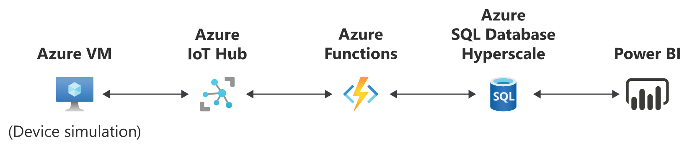
Recipe for IoT solutions using Azure SQL Database
Notes:
Anna
You now understand how and why Azure SQL Database is a good fit for IoT applications. Following the distributor scenario, you'll deploy and configure a baseline IoT solution and implement the best practices for achieving scale. The template you deploy can be a great starting point for other IoT scenarios that you or your organization seek to create.
The template is an Azure Resource Manager (ARM) template, which uses JSON files to define the infrastructure and configuration for a solution. Typically, there is a template file and a parameters file, which contain what to deploy and specifications respectively. You can then deploy the template and parameters with the Azure CLI or Azure PowerShell. In the exercises that follow, you will explore the contents and configurations of what's deployed and the associated code samples.

Slide 23

Question 1
In the typical IoT solution mentioned, what is the purpose of warm storage?
Optimized storage for large data volumes at a reasonable cost.
Perform real-time streaming for capturing low latency events.
Persist low latency events and messages that need to be ingested efficiently at a high rate.
Manage bi-directional communications with devices, like queuing events and messages.

Slide 24
Question 1
In the typical IoT solution mentioned, what is the purpose of warm storage?
Optimized storage for large data volumes at a reasonable cost.
Perform real-time streaming for capturing low latency events.
Persist low latency events and messages that need to be ingested efficiently at a high rate.
Manage bi-directional communications with devices, like queuing events and messages.
Notes:
Explanation: Correct!

Slide 25
Question 2
What is the advantage of using Azure SQL Database for IoT scenarios?
Azure SQL Database can ingest millions of events per second and while querying ingested data with sub-second latency.
Azure SQL Database can integrate with other services including Azure Functions and Azure Stream Analytics.
Azure SQL Database supports real-time analytics, you can configure many read-only replicas if needed.
All of the above

Slide 26
Question 2
What is the advantage of using Azure SQL Database for IoT scenarios?
Azure SQL Database can ingest millions of events per second and while querying ingested data with sub-second latency.
Azure SQL Database can integrate with other services including Azure Functions and Azure Stream Analytics.
Azure SQL Database supports real-time analytics, you can configure many read-only replicas if needed.
All of the above
Notes:
Explanation: Correct! Azure SQL Database is great for IoT because it can scale, integrate, and support real-time analytics.

Slide 27
Store and process IoT data in real time with Azure SQL Database
Notes:
Anna – Anna to ask Silvano about any patterns for ingesting a ton of data
IoT workloads can be characterized by high rates of input data, on both steady and burst streams, to be ingested from devices.
Recall in the distributor scenario, your IoT solution will be taking in real-time telemetry data from thousands of trucks every second. Here, you'll learn how to implement a design pattern to ingest data and optimize storage of that data.

Slide 28
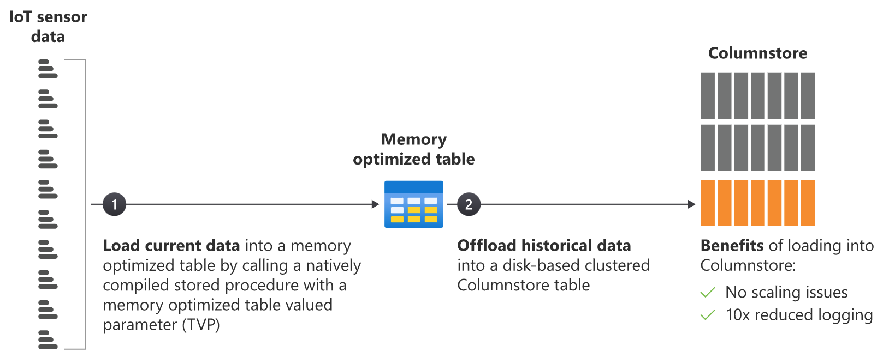
Ingest millions of events per second with the shock absorber pattern
Notes:
Silvano – 3 min
A common design pattern for systems, like the truck fleet example, involves a landing zone (or staging area) that is optimized for absorbing the shock of the high and spiky input rate. After, the data flows into its final destination (usually one or more tables) that instead is optimized for persistence and analysis. There are few knobs we can use to optimize our data models for these purposes. Different indexing approaches can be taken for different pieces of a database. For example, a light indexing approach better suits a higher ingestion rate, while a more comprehensive to approach favors query and retrieval. Azure SQL Database also provides specialized capabilities like in-memory OLTP tables and columnstore indexes that can be used together to implement what is often referred to as a shock absorber pattern for IoT solutions. Let's dive into the pattern you see below.
By using in-memory OLTP tables (only available on Premium/Business Critical service tiers) as a landing zone for incoming streams of events and messages from IoT devices, you can largely eliminate latching and locking contention that can affect regular tables (subject to things like last page insert scenarios). In-memory OLTP tables avoid latch and lock contention, because they are optimized around the data being in-memory. Another benefit of this approach is the ability to reduce the overhead of transaction log operations by minimizing IOs for SCHEMA_ONLY tables (where the risk of losing some events in a failure is acceptable) or to reduce the impact of log updates for tables with schema and data persistence. By combining in-memory OLTP tables with natively compiled stored procedures, you can also improve the execution performance for all critical data management operations on ingested data.
A common solution architecture would likely include an event store, like Azure IoT Hub. In this case, events flow from devices, and an event processor pulls events from the store, using a memory-optimized table-valued parameter that batches hundreds or thousands of incoming events into a single data structure. This process would greatly reduce the number of database round trips. It could also improve throughput to up to millions of events per second.

Slide 29
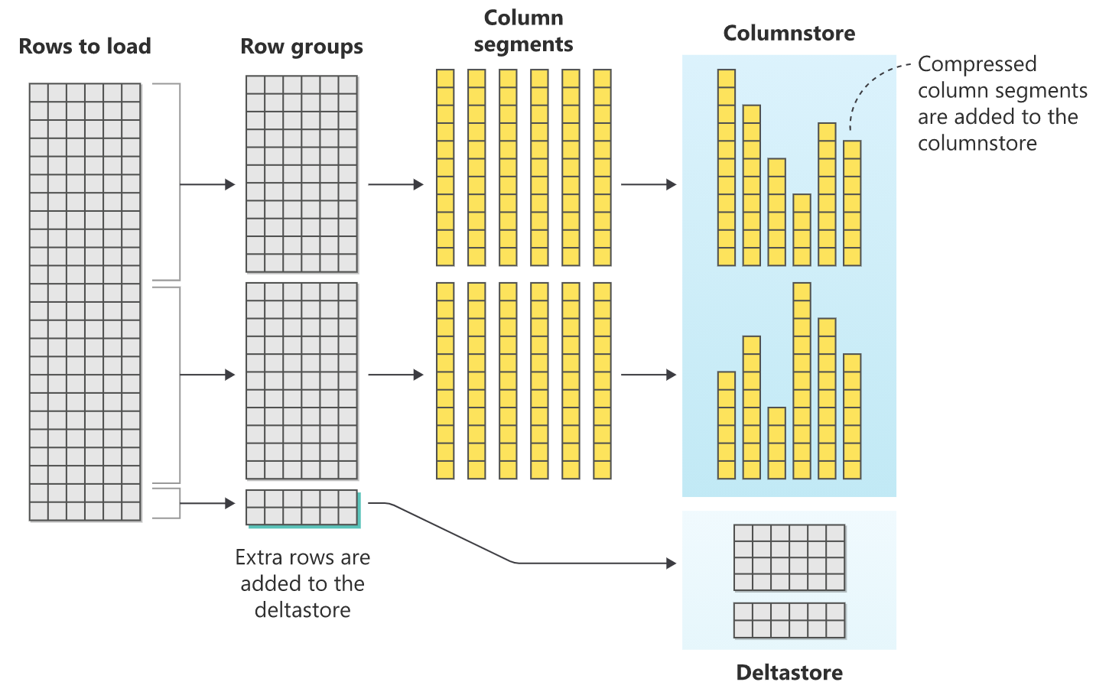
Columnstore indexes
Notes:
Silvano – 3 min
With billions of events potentially ingested per day, the maximum in-memory OLTP table size (that is proportional to Azure SQL compute size utilized) could be reached. A common approach is to use those tables for the ?hot? portion of the dataset (newly ingested data). Events can then be offloaded to disk-based tables, which are optimized for persistence and analytics. Using a time or data volume trigger, you can use a bulk loading process to store the data in a columnstore-based table.
A columnstore-based table contains data that's logically organized as a table with rows and columns, and physically stored in a column-wise data format. Bulk loading is the most performant way to move data into a columnstore index because it operates on batches of rows. Bulk loading fills rowgroups to maximum capacity and compresses them directly into the columnstore. Only rows that don't meet the minimum of 102,400 rows per rowgroup go to the deltastore. To perform a bulk load, often the bcp Utility is used.
By selecting the right batch size (for example, between 102,400 and 1,048,576, depending on your events generation rate and logic) you can maximize efficiency. Appropriate batching eliminates the need to move new data rows into columnstore's delta rowgroup and wait for the Tuple Mover to compress them. Instead, batching allows you to go straight to a compressed rowgroup, which reduces logging and increases overall throughput by at least 10 times. Plus, you still achieve a similar level of data compression, which is important when you're dealing with hundreds of billions of events.
Once the data is offloaded to a columnstore-based table, events can be efficiently analyzed with aggregations and time-series analytical workloads, without impacting the ingestion process. By adopting this design pattern for your IoT solutions, you can use a familiar relational engine environment while scaling to billions of events ingested per day and terabytes of compressed historical data stored.

Slide 30
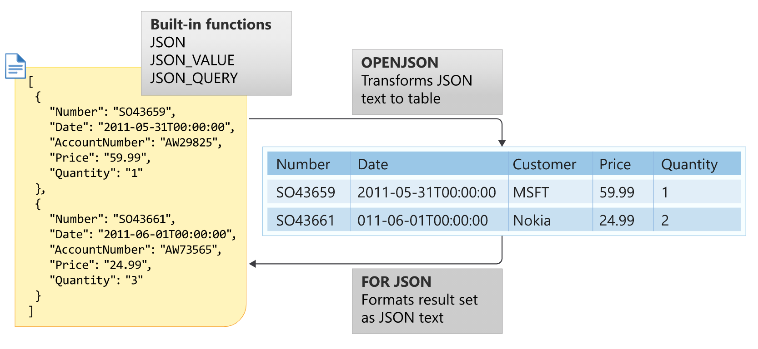
Optimize storage and retrieval for large volumes of IoT data
Store raw data in the database
Optimize JSON data retrieval from the database
Notes:
Silvano – 3 min
IoT solutions generally produce large data volumes. Whether you need to store data in raw formats, like JSON, to preserve and process the original information, or you can shred messages into more schematized/relational table structures, it is not uncommon that these solutions will have to deal with billions of events/messages and terabytes of data to manage. You will likely need to optimize your storage tier for costs, data volume, and performance.
Depending on your requirements, you can certainly think about persisting less-frequently accessed, raw data fragments in a less expensive storage layer like Azure Blob Storage. Then, you can process them with an analytical engine like Spark in Azure Synapse Analytics (in a canonical modern data warehouse or lambda architecture scenario). That solution works well for data transformations or non-interactive, batch analytics scenarios. However, if you need to frequently access and query both raw and structured data, you can use Azure SQL Database as a serving layer. This decision would simplify your solution architecture since both warm and cold data are persisted in the same store.
Azure SQL Database supports storing raw JSON messages as NVARCHAR(MAX) data types. These messages can be inserted into tables or provided as an argument in stored procedures using standard Transact-SQL (T-SQL). Any client-side language or library that works with string data in Azure SQL Database will also work with JSON data. Additionally, JSON can be stored in any table that supports the NVARCHAR type, which includes memory-optimized or columnstore-based tables and does not introduce any constraints in the client-side code or in the database layer.
To optimize storage for large volumes of IoT data, you can use clustered columnstore indexes and their intrinsic data compression benefits to dramatically reduce storage needs. On text-based data, it's not uncommon to get more than 20x compression ratio, depending on your data shape and form.
Storing large amounts of data efficiently may not be enough, as you may struggle to extract great insights and analysis from that store. Azure SQL Database's battled-tested query processor and storage engine provides extra options to optimize the data access path.
Azure SQL Database provides full functionality and support for JSON data. With JSON functions in T-SQL, like ISJSON, JSON_VALUE, and JSON_QUERY, you can treat JSON data like any other SQL data type. You can extract values from the JSON test to use JSON data in the SELECT statement or in a search predicate. If your JSON structure happens to be stable and known upfront, the best option is to design your relational schema to accommodate the most relevant attributes from JSON data. You can then use OPENJSON to transform these attributes to row fields when inserting new data.
The result is fully relational columns (with optimized SQL data types) that can be used for retrieval and analytical purposes, including complex filtering and aggregations. This data will be properly indexed to support various access paths. You can additionally decide to keep the entire JSON fragment and store it in a NVARCHAR(MAX) field in the same table if further processing may be needed.
Since columnstore-based tables are optimized for scans and aggregations rather than key lookup queries, you can also create computed columns based on JSON functions that are exposed as regular relational columns within the original JSON column, simplifying query design and development. You can further optimize data retrieval of critical queries and access paths by creating regular (row-based) nonclustered indexes on computed columns. While these indexes will slightly increase your overall storage needs, they will help the query processor filter rows on key lookups and range scans. These indexes will also help with other operations like aggregations.
You can add computed columns and related indexes at any time, so in the distributor scenario, or any other scenario, you should test to find the right balance for your solution.

Slide 31
Optimize data retrieval and analytics with replicas in Azure SQL Database
Geo-replication
Auto-failover groups
Business critical
Hyperscale supports
Geo-replication (currently in preview and limited to a single geo-replicated database)
0-4 High Availability (HA) replicas that can be used for read-only workloads
0-30 Named replicas (read-only) (currently in preview) that can have different names, authentication, authorization, and compute sizes than the primary
Notes:
Anna, and to end by asking Silvano what other things folks should consider
Depending on your workload requirements, it may be beneficial to separate your read and write workloads with secondary replicas in Azure SQL Database. There are several different options:
Geo-replication allows you to create readable secondary databases in the same or different region.
Auto-failover group allows you to manage the replication and failover of a group of databases on a server to another region. The secondary group of databases in the failover group can be used for read-only purposes.
Business critical is a service tier in Azure SQL Database that includes one free, readable replica
Hyperscale is a service tier in Azure SQL Database that supports geo-replication (currently in preview and limited to a single geo-replicated database), 0-4 High Availability (HA) replicas that can be used for read-only workloads, and 0-30 Named replicas (read-only) (currently in preview) that can have different names, authentication, authorization, and compute sizes than the primary. For the most up-to-date status on the preview and details, refer to the documentation.
Regardless of the option you select, you can use replicas to scale out IoT data consumers without impacting the ingestion process. These replicas can support read workloads like alerting, dashboards, analytics, and machine learning.

Slide 32

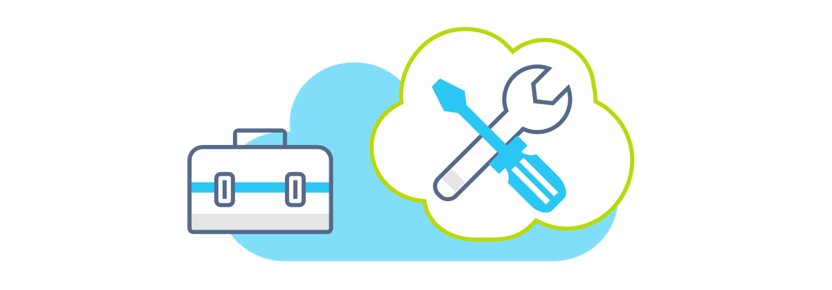
Other things to keep in mind
Partitioning
Data compression
Sliding windows
Index maintenance
Notes:
Silvano – 3 min
There are a few other things you should keep in mind when it comes to managing such large IoT stores with Azure SQL Database: partitioning, data compression, and index maintenance. Let's start with some tips for table partitioning:
Partition (aligned!) event tables and indexes based on the desired time granularity. Depending on your retention policies, this granularity could be daily, weekly, monthly, etc.
Avoid thousands of partitions as they can be ineffective on both management and operations.
Automate the implementation of sliding window strategies by dropping older time periods and creating new tables. As an alternative, you can create multiple tables that represent time periods (for example, Q1-Q2). You can reduce concurrency issues by creating aggregated views for consumers.
As for data compression, columnstore native compression can easily provide 25x reduction for IoT events. Additionally, for scenarios where columnstore is not a great solution (for example, tables with many UPSERT operations), use page compression on row store tables.
Finally, avoid rebuilding and reorganizing indexes for scenarios where the event data is mostly static.

Slide 33
Question 3
What is not a piece of the shock absorber pattern?
Load current data into a memory optimized table.
Call a natively compiled stored procedure with a memory-optimized table-valued parameter.
Use JSON support for high ingestion.
Offload historical data into a disk-based clustered columnstore table.

Slide 34
Question 3
What is not a piece of the shock absorber pattern?
Load current data into a memory optimized table.
Call a natively compiled stored procedure with a memory-optimized table-valued parameter.
Use JSON support for high ingestion.
Offload historical data into a disk-based clustered columnstore table.
Notes:
Explanation: Correct! Azure SQL Database supports JSON, but it is not a direct requirement for the shock absorber pattern.

Slide 35
Question 4
Considering all the Azure SQL Database Hyperscale replication options, what is the current maximum number of replicas you could configure for read-scaling?
4
30
34
35

Slide 36
Question 4
Considering all the Azure SQL Database Hyperscale replication options, what is the current maximum number of replicas you could configure for read-scaling?
4
30
34
35
Notes:
Explanation: Correct! You can configure 0-4 high availability replicas, 0-30 named replicas, plus 1 geo-replica. When geo-replication becomes generally available, this number may increase!

Slide 37
Putting it all together
Notes:
Anna to ask about some customers

Slide 38
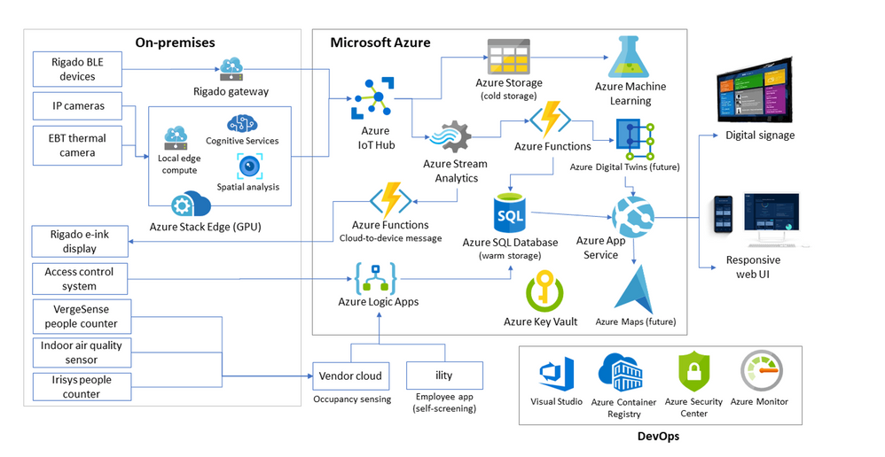
Customers using Azure SQL Database for IoT in production today
RXR Realty
Notes:
Silvano
RXR Realty is the third-largest real estate owner in New York City, with over 25 million square feet of space across the tri-state area, including some of the most iconic addresses in Manhattan. When the COVID-19 pandemic hit, the company needed a way to integrate new safety measures for tenants after its buildings reopened for business. Working with key partners McKinsey & Co., Infosys, Rigado, and Microsoft, RXR used Microsoft Azure to create and deploy an intelligent, secure, hyperscalable solution-in just a few months.
The solution is named RxWell?-a comprehensive, public-health?based, data-driven program that merges physical and digital assets to help keep employees informed and supported during the ?new abnormal? and beyond. Powered by the Internet of Things (IoT) and the intelligent edge, and firmly rooted in responsible artificial intelligence (AI) principles, RxWell combines real-time computer vision, sensors, AI, mobile apps and dashboards, and in-person service offerings. And Azure is making it all possible.
RXR Realty is using Azure SQL Database as warm storage where events flow through Azure Stream Analytics and Azure Functions to power multiple dashboards and reporting applications on mobile and embedded devices on-site.
Schneider Electric, and partner ThoughtWire, created an end-to-end solution for facilities and clinical operations management in healthcare settings. The solution uses Internet of Things (IoT) technology and Microsoft Azure cloud services to help hospitals and clinics reduce costs, minimize their carbon footprint, promote better patient experiences and outcomes, and increase staff satisfaction. The ThoughtWire application suite uses Azure Virtual Machines infrastructure as a service (IaaS) capabilities to run virtual and containerized workloads that support the ThoughtWire digital twin platform and Smart Hospital Suite in Azure. It also uses Azure SQL Database, which provides the right security controls for solution benefits like encrypting data at rest.
HB Reavis uses the power of Microsoft Azure IoT Hub, Azure SQL Database, and Stream Analytics. It captures complex IoT metrics essential for monitoring and analyzing diverse aspects of efficient workspace, such as office utilization, environmental insights (CO2, temperature, humidity), and general team dynamics and interactions. Once this data is collected, the platform converts it into actionable insights and visualizes the results on interactive Microsoft Power BI dashboards.
VERSE Technology is building an edge-to-cloud solution based on Microsoft Azure for one of the world's largest baking companies, Grupo Bimbo. In the past year it has converted 15 factories, with many more scheduled soon. Now, with all this data being processed, analyzed, and visualized in real time, Bimbo can get an unprecedented, accurate picture of the company's production process and begin transforming its business.
VERSE has designed a connected cloud solution for Bimbo based on Azure. Azure IoT Hub connects all the data streamed to the platform from different edge devices and sensors. Azure SQL Database is the highly scalable solution for storing RPMs, temperature, gas consumption, and more. This first phase encompasses more than 1,000 devices at the edge, with a range of communication protocols??RF, cellular, and Wi-Fi according to the needs of the location. The company plans to expand to more than 10,000 devices soon.

Slide 39
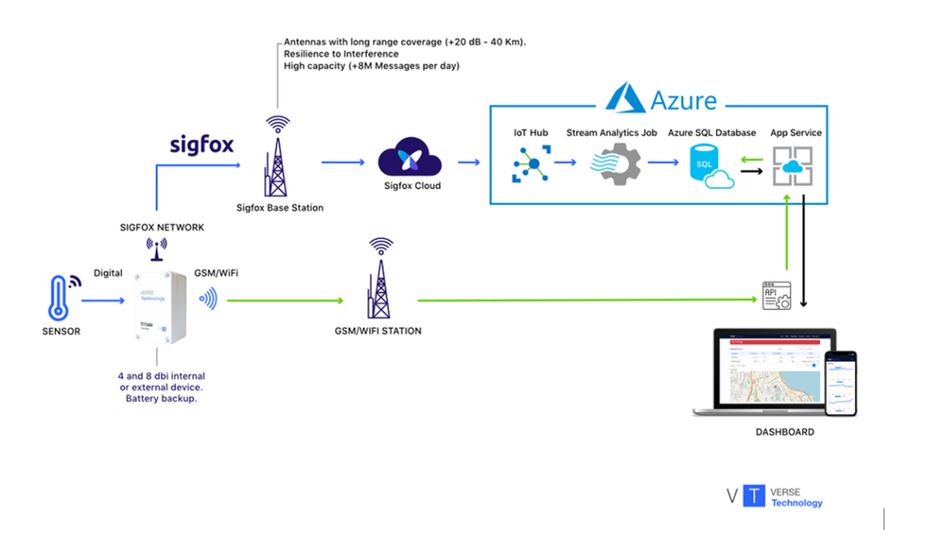
Customers using Azure SQL Database for IoT in production today
VERSE Technology
Notes:
Anna
RXR Realty is the third-largest real estate owner in New York City, with over 25 million square feet of space across the tri-state area, including some of the most iconic addresses in Manhattan. When the COVID-19 pandemic hit, the company needed a way to integrate new safety measures for tenants after its buildings reopened for business. Working with key partners McKinsey & Co., Infosys, Rigado, and Microsoft, RXR used Microsoft Azure to create and deploy an intelligent, secure, hyperscalable solution-in just a few months.
The solution is named RxWell?-a comprehensive, public-health?based, data-driven program that merges physical and digital assets to help keep employees informed and supported during the ?new abnormal? and beyond. Powered by the Internet of Things (IoT) and the intelligent edge, and firmly rooted in responsible artificial intelligence (AI) principles, RxWell combines real-time computer vision, sensors, AI, mobile apps and dashboards, and in-person service offerings. And Azure is making it all possible.
RXR Realty is using Azure SQL Database as warm storage where events flow through Azure Stream Analytics and Azure Functions to power multiple dashboards and reporting applications on mobile and embedded devices on-site.
Schneider Electric, and partner ThoughtWire, created an end-to-end solution for facilities and clinical operations management in healthcare settings. The solution uses Internet of Things (IoT) technology and Microsoft Azure cloud services to help hospitals and clinics reduce costs, minimize their carbon footprint, promote better patient experiences and outcomes, and increase staff satisfaction. The ThoughtWire application suite uses Azure Virtual Machines infrastructure as a service (IaaS) capabilities to run virtual and containerized workloads that support the ThoughtWire digital twin platform and Smart Hospital Suite in Azure. It also uses Azure SQL Database, which provides the right security controls for solution benefits like encrypting data at rest.
HB Reavis uses the power of Microsoft Azure IoT Hub, Azure SQL Database, and Stream Analytics. It captures complex IoT metrics essential for monitoring and analyzing diverse aspects of efficient workspace, such as office utilization, environmental insights (CO2, temperature, humidity), and general team dynamics and interactions. Once this data is collected, the platform converts it into actionable insights and visualizes the results on interactive Microsoft Power BI dashboards.
VERSE Technology is building an edge-to-cloud solution based on Microsoft Azure for one of the world's largest baking companies, Grupo Bimbo. In the past year it has converted 15 factories, with many more scheduled soon. Now, with all this data being processed, analyzed, and visualized in real time, Bimbo can get an unprecedented, accurate picture of the company's production process and begin transforming its business.
VERSE has designed a connected cloud solution for Bimbo based on Azure. Azure IoT Hub connects all the data streamed to the platform from different edge devices and sensors. Azure SQL Database is the highly scalable solution for storing RPMs, temperature, gas consumption, and more. This first phase encompasses more than 1,000 devices at the edge, with a range of communication protocols??RF, cellular, and Wi-Fi according to the needs of the location. The company plans to expand to more than 10,000 devices soon.

Slide 40
Azure SQL Database for IoT Solutions
You have now learned
How Azure SQL Database can be deployed and configured to support IoT scenarios that require scale in both ingestion and reads
How to deploy a solution using a template for any IoT scenario with Azure SQL Database
Notes:
Anna
Azure SQL Database provides a great platform for the distributor scenario. In the scenario, you were responsible for monitoring thousands of devices on trucks across the country. With Azure SQL Database, you can insert millions of events per second, use replicas for read scale, and obtain limitless storage through the Hyperscale tier. You deployed a template that allows you to simulate the scenario, which also involved configuring and optimizing your database. With this solution, you can monitor the health of your fleet of trucks, and you're one step closer to identifying when preventative maintenance should occur. Next steps for this scenario could include building a Power BI dashboard or using Azure Machine Learning to build the model that predicts when failures may occur.
The solution you've now learned how to deploy and monitor is not just applicable to the distributor scenario. This solution can be modified to fit the needs of any IoT scenario you want to tackle. In the references section, there are several customer stories for you to take a closer look at. These customers were able to use Azure SQL Database to meet their IoT needs for industries including real estate, health, electricity, workspace management, manufacturing,

Slide 41
Summary
Create scalable IoT solutions using Azure SQL Database
Use the template provided for many IoT use cases.
Notes:
Anna
Azure SQL Database provides a great platform for the distributor scenario. In the scenario, you were responsible for monitoring thousands of devices on trucks across the country. With Azure SQL Database, you can insert millions of events per second, use replicas for read scale, and obtain limitless storage through the Hyperscale tier. You deployed a template that allows you to simulate the scenario, which also involved configuring and optimizing your database. With this solution, you can monitor the health of your fleet of trucks, and you're one step closer to identifying when preventative maintenance should occur. Next steps for this scenario could include building a Power BI dashboard or using Azure Machine Learning to build the model that predicts when failures may occur.
The solution you've now learned how to deploy and monitor is not just applicable to the distributor scenario. This solution can be modified to fit the needs of any IoT scenario you want to tackle. In the references section, there are several customer stories for you to take a closer look at. These customers were able to use Azure SQL Database to meet their IoT needs for industries including real estate, health, electricity, workspace management, manufacturing,

Slide 42



Resources
Microsoft Learn module
aka.ms/azuresqliot
Code sample
aka.ms/azuresqliotsample
Azure SQL YouTube
aka.ms/azuresqlyt
Notes:
Anna but to ask Silvano if he has any additional advice
Azure SQL Database provides a great platform for the distributor scenario. In the scenario, you were responsible for monitoring thousands of devices on trucks across the country. With Azure SQL Database, you can insert millions of events per second, use replicas for read scale, and obtain limitless storage through the Hyperscale tier. You deployed a template that allows you to simulate the scenario, which also involved configuring and optimizing your database. With this solution, you can monitor the health of your fleet of trucks, and you're one step closer to identifying when preventative maintenance should occur. Next steps for this scenario could include building a Power BI dashboard or using Azure Machine Learning to build the model that predicts when failures may occur.
The solution you've now learned how to deploy and monitor is not just applicable to the distributor scenario. This solution can be modified to fit the needs of any IoT scenario you want to tackle. In the references section, there are several customer stories for you to take a closer look at. These customers were able to use Azure SQL Database to meet their IoT needs for industries including real estate, health, electricity, workspace management, manufacturing,

Slide 43
Exercise
Deploy the solution with Azure
Notes:
Anna 15 min
Link to published module on Learn: https://docs.microsoft.com/en-us/learn/modules/learn-pr/azure/deploy-iot-solution-azure-sql-database/3-exercise-deploy

Slide 44
Deploy the solution with Azure
Deploy the Azure Resource Manager (ARM) template
Deploy the schema to Azure SQL Database
Setting up your environment and deploying the template is the first step in getting hands on with Azure SQL Database for IoT scenarios.
Configure the application settings for the iot-workload function
Deploy the Azure Function code with GitHub Actions
aka.ms/azuresqliot
Connect to the Azure Virtual Machine and start the simulator
Work with IoT data in Azure SQL Database
Confirm the configurations of the database
Optimizing the storage and retrieval of IoT data is important in maximizing ingestion rates and minimizing the time to insights.
Monitor the captured events in Azure SQL Database
Notes:
Workt through deploying the ARM template together

Slide 45

15 min break
See you back here soon!
Notes:
9:40-9:55

Slide 46
Deploy the solution with Azure
Deploy the Azure Resource Manager (ARM) template
Deploy the schema to Azure SQL Database
Setting up your environment and deploying the template is the first step in getting hands on with Azure SQL Database for IoT scenarios.
Configure the application settings for the iot-workload function
Deploy the Azure Function code with GitHub Actions
aka.ms/azuresqliot
Connect to the Azure Virtual Machine and start the simulator
Work with IoT data in Azure SQL Database
Confirm the configurations of the database
Optimizing the storage and retrieval of IoT data is important in maximizing ingestion rates and minimizing the time to insights.
Monitor the captured events in Azure SQL Database
Notes:
Work through the rest of the exercises

Slide 47
Exercise
Work with IoT data in Azure SQL Database
Notes:
Anna – after the exercise could pass to Silvano to discuss how to take it further
Link to published module on Learn: https://docs.microsoft.com/en-us/learn/modules/learn-pr/azure/deploy-iot-solution-azure-sql-database/5-exercise-configure

Slide 48
Work with IoT data in Azure SQL Database
Confirm the configurations of the database
Optimizing the storage and retrieval of IoT data is important in maximizing ingestion rates and minimizing the time to insights.
Monitor the captured events in Azure SQL Database
Notes:
This slide sets up the context BEFORE the demo, and provides a summary AFTER the demo
https://docs.microsoft.com/en-us/learn/modules/learn-pr/azure/deploy-iot-solution-azure-sql-database/5-exercise-configure

Slide 49
Build serverless, full stack applications in Azure https://aka.ms/azuremodernapps
Twitter: @AnalyticAnna
LinkedIn: amthomas46
Anna Hoffman
Azure Data Program Management
Microsoft
Notes:
Anna then Davide introduce

Slide 50
Agenda
Keynote, Sanjay Mishra
Deploy IoT solutions with Azure SQL Database
Break
HANDS ON
Build serverless, full stack apps with Azure
Module 1: Azure SQL Database
Break
HANDS ON
Lunch
Build serverless, full stack apps with Azure
Modules 2-4: Functions, Static web apps
HANDS ON
Break
Closing keynote, Sanjay Mishra
Parking lot topics and Q&A
Notes:
Anna
9:55

Slide 51
Part 2: Build serverless, full stack applications in Azure
Anna Hoffman
Senior PM Manager
Microsoft
@AnalyticAnna
Davide Mauri
Senior Program Manager
Microsoft
@mauridb
Notes:
Anna, but also to ask Silvano to introduce himself, and also to ask Silvano why we created this module
Link to published module on Learn: https://docs.microsoft.com/en-us/learn/modules/learn-pr/azure/deploy-iot-solution-azure-sql-database/
Schedule for 60 min session:
Intro and overview: 7 min
Intro and architecture: 15 min
Exercise 1: 10 min
Optimize and process: 15 min
Exercise 2: 5 min
Putting it all together: 8 min

Slide 52
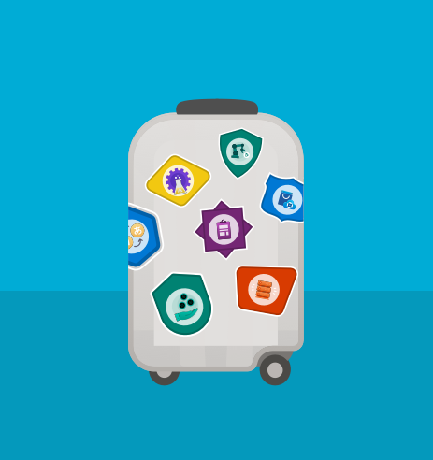
Build serverless, full stack applications in Azure New learning path with free Azure sandbox
Architect
Architect modern applications using Azure SQL Database
Deploy
Deploy serverless APIs with Azure Functions, Logic Apps, and Azure SQL Database
Build
Build full stack applications with Azure Static Web Apps and Azure SQL Database
Automate
Architect full stack applications and automate deployments with GitHub
aka.ms/AzureModernApps
Notes:
Anna
Learn how to create, build, and deploy modern full stack applications in Azure by using the language of your choice (Python, Node.js, or .NET) and with a Vue.js frontend. Topics covered include modern database capabilities, CI/CD and DevOps, backend API development, REST, and more. Using a real-world scenario of trying to catch the bus, you will learn how to build a solution that uses Azure SQL Database, Azure Functions, Azure Static Web Apps, Logic Apps, Visual Studio Code, and GitHub Actions.

Slide 53


Catching (or not catching) the bus
Notes:
Before animating, Anna to ask Davide: It’s kind of a funny story how this all started. Davide, can you tell folks the reason behind the scenario for today’s session?
Davide: *explains*

Slide 54
Catching the bus
Notes:
Davide

Slide 55

Live & interactive
Say “hi” and ask questions in the chat
Notes:
Anna

Slide 56
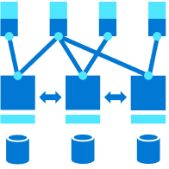
Build serverless, full stack applications in Azure
Create Foundation Modern Apps
Deploy serverless APIs with Azure Functions, Logic Apps, and Azure SQL Database
Build full stack applications with Azure Static Web Apps and Azure SQL Database
Architect full-stack applications and automate deployments with GitHub
aka.ms/AzureModernApps
Notes:
Anna

Slide 57
Create foundation for modern apps
Module 1
Notes:
Anna:

Slide 58
Select a database service
Solution requirements
Website for monitoring real-time bus locations
Notifications when a bus is close by
Deployment automation
Available data
Real-time bus data in JSON documents
Route data available in a flat file
Database
API
Application
Solution
Summary
Notes:
Anna:

Slide 59
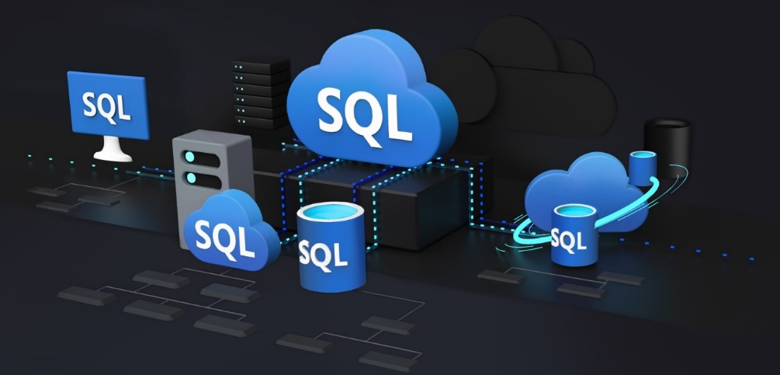
Modern database requirements
Pay only for what you need, when you need it (serverless)
Support development workflows
JSON and geospatial support by default
Future-proof applications
Azure SQL
Database
API
Application
Solution
Summary
Notes:
Anna
At the end, asks Davide: Can you tell us more about how Azure SQL meets the requirements for our bus app and other modern apps?

Slide 60
Azure SQL Database is the best database for modern apps
Run any workload anywhere on the industry-leading SQL Server engine
Built-in security
Versionless
Apply your current skills
Analytical processing and high-concurrency optimizations
Developer experience
Native geospatial support
Multi-model capabilities (JSON, Graph, Key-Value, XML)
Serverless and Hyperscale
Relational Engine is the backbone of everything
Database
API
Application
Solution
Summary
Notes:
Davide but be brief, pick a few
Anna to ask him to dive deeper into JSON / geospatial

Slide 61
Azure SQL Database supports JSON
Storage, manipulation and creation of JSON documents supported
Built-in functions
ISJSON
JSON_VALUE
JSON_QUERY
OPENHJSON
Transform JSON text to table
[
{
“Number”:”SO43659”,
“Date”:”2011-05-31T00:00:00”
“AccountNumber”:”AW29825”,
“Price”:59.99,
“Quantity”:1
},
{
“Number”:”SO43661”,
“Date”:”2011-06-01T00:00:00”
“AccountNumber”:”AW73565”,
“Price”:24.99,
“Quantity”:3
}
]
Number | Date | Customer | Price | Quantity
SO43659 | 2011-05-31T00:00:00 | MSFT | 59.99 | 1
SO43661 | 2011-06-01T00:00:00 | Nokia | 24.99 | 3
FOR JSON
Formats results set as JSON text
Database
API
Application
Solution
Summary
Notes:
Davide

Slide 62
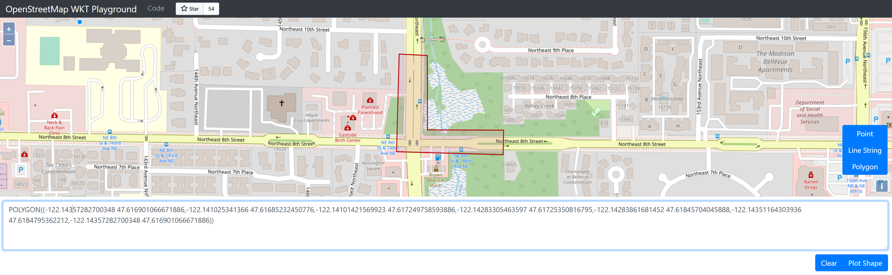
Azure SQL Database supports spatial
Database
API
Application
Solution
Summary
Notes:
Davide

Slide 63
CI/CD with Azure SQL Database
To have a fully modern development experience, also the database should be in the CI/CD pipeline. Two possible approaches
Desired-State Deployment
Migration / Scripts Deployment
Both supported with using GitHub Actions
Via Azure SQL GitHub actions
Via regular .NET integration in GitHub
Database
API
Application
Solution
Summary
Notes:
Davide

Slide 64
Demo
JSON and Geospatial support in Azure SQL Database
Notes:
Davide demo part 2:
go through notebook 02-json-gepspatial-sql-db.ipynb Parts 1 and 2 only

Slide 65

Exercise! Deploy and configure Azure SQL Database
Configure your environment
Deploy Azure SQL Database
Use GitHub Actions to configure Azure SQL Database
Import Route Data into Azure SQL Database
Explore JSON and geospatial support
Module 1: aka.ms/azuremodernapps01
Units 3, 5, and 7
Notes:
11-11:10
Anna walks through Unit 3 and first part of 5 with attendees

Slide 66
15 min break
See you back here soon!
Notes:
Should be around 11:10-11:25

Slide 67
Exercise! Deploy and configure Azure SQL Database
Configure your environment
Deploy Azure SQL Database
Use GitHub Actions to configure Azure SQL Database
Import Route Data into Azure SQL Database
Explore JSON and geospatial support
Module 1: aka.ms/azuremodernapps01
Units 3, 5, and 7
Notes:
Anna walks through rest of 5 and all of 7 with attendees

Slide 68
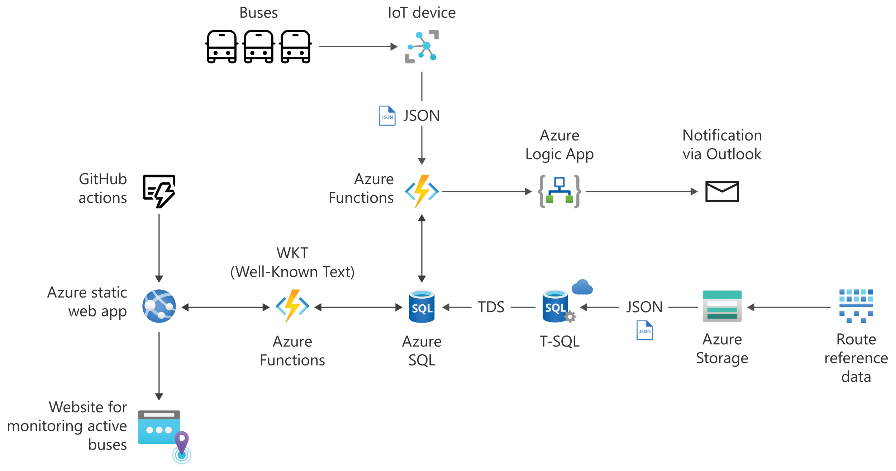

Architecture
Database
API
Application
Solution
Summary
Notes:
Anna explain what we have so far and what the next steps are

Slide 69
60 min break
See you back here soon!
Notes:
Should be around 12PM
Anna needs to get whole solution deployed and working

Slide 70
Deploy serverless APIs with Azure Functions, Logic Apps, and Azure SQL Database
Module 2
Notes:
Anna 1PM

Slide 71
Select an API service
Solution requirements
Website for monitoring real-time bus locations
Notifications when a bus is close by
Deployment automation
API service requirements
Get the latest data and identify buses in monitored routes and geofence activations
Send an email notification for each activated bus
Database
API
Application
Solution
Summary
Notes:
Anna to recap the requirements. Then to ask Davide: What do you think we should use?

Slide 72

Azure Functions
Accelerate and simplify application development
Triggers supported: Queue, Timer, Event Grid, and HTTP
Serverless and scalable
Database
API
Application
Solution
Summary
Notes:
Davide to explain that we might be able to use Azure Functions and explain what Azure Functions are

Slide 73
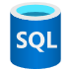
Catching the bus with Azure Functions
Every 15 seconds, accomplish the following tasks:
Determine what the monitored routes are
Get the latest bus data
Identify buses in monitored routes and activating a geofence
Send an email notification for each activated bus
Database
API
Application
Solution
Summary
Notes:
Davide to explain the different things we’ll use Azure Functions for and the integrations with Azure SQL Database.
At the end, Davide to ask Anna: Finally, we want to send a notification so people know when their bus is closeby and they should head to the bus stop. Have any ideas what we can use for that?

Slide 74

Push notifications with Azure Logic Apps
Low-code/no-code development platform
Serverless cloud service
Automate and orchestrate tasks and workflows
Integrate apps, data, systems, and services
Hundreds of connectors
SQL Server, Azure SQL, Outlook, SMS, file shares
Database
API
Application
Solution
Summary
Notes:
Anna: Well we could probably code something up that connects to Outlook and Azure Functions and then set up an additional endpoint. However, I think Azure Logic Apps is going to be great for this.
Explains Logic Apps. Explains how it will work in the solution

Slide 75
Demo
Configure and deploy Azure Functions
Notes:
Demo how the Azure Functions code works and runs locally – Davide
Demo GitHub Actions Azure Logic Apps / monitor and show incoming emails – Anna

Slide 76
Configure and deploy Azure Functions
Run Azure Functions locally
Configure for CI/CD with GitHub
Push notifications with Azure Logic Apps
Monitor results
Notes:
Demo how the Azure Functions code works and runs locally – Davide
Demo GitHub Actions Azure Logic Apps / monitor and show incoming emails – Anna

Slide 77
Knowledge check
Notes:
Anna to lead and then ask Davide what he thinks the answer is (it is D)

Slide 78
Question 1
Which service(s) will be used to process real-time data and identify if a bus is within a geofence?
Azure Functions
Azure SQL Database
Azure Static Web Apps and Azure Functions
Azure Functions and Azure SQL Database
Notes:
Anna to lead and then ask Davide what he thinks the answer is (it is D)
Explanation: That's correct! Azure Static Web Apps is a combination of a static web app and Azure Functions.

Slide 79
Question 1
Which service(s) will be used to process real-time data and identify if a bus is within a geofence?
Azure Functions
Azure SQL Database
Azure Static Web Apps and Azure Functions
Azure Functions and Azure SQL Database
Notes:
Anna to lead and then ask Davide what he thinks the answer is (it is D)

Slide 80
Architecture
Database
API
Application
Solution
Summary
Notes:
Anna to ask Davide to review the architecture of what we have so far.
Davide: *explains* and ends by talking about how the next step is to have an application

Slide 81
Build full stack applications with Azure Static Web Apps and Azure SQL Database
Module 3
Notes:
Hopefully we’re at the 30-35 min mark here (so it should be around 4PM, otherwise, speed up!)
Anna to exclaim how we’ve reviewed everything and now it’s time to build our web application!

Slide 82
Select an application hosting service
Solution requirements
Website for monitoring real-time bus locations
Notifications when a bus is close by
Deployment automation
Web application requirements
Website displaying a map with real-time buses and geofences
Filter based on bus route(s) and geofence(s)
Database
API
Application
Solution
Summary
Notes:
Anna to recap the solution requirements and web app requirements

Slide 83
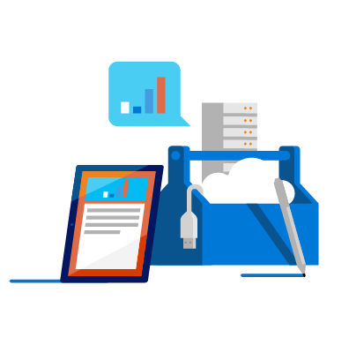
Accelerate app development with Azure Static Web Apps
Azure Static Web Apps is a modern web app service that offers streamlined full-stack development from source code to global high availability
Database
API
Application
Solution
Summary
Notes:
Anna to explain what Azure Static Web Apps is. It’s been selected as the best option for our app. Let’s explore why.
Davide, can you tell us what languages static web apps support and if that’s good enough for our scenario?

Slide 84

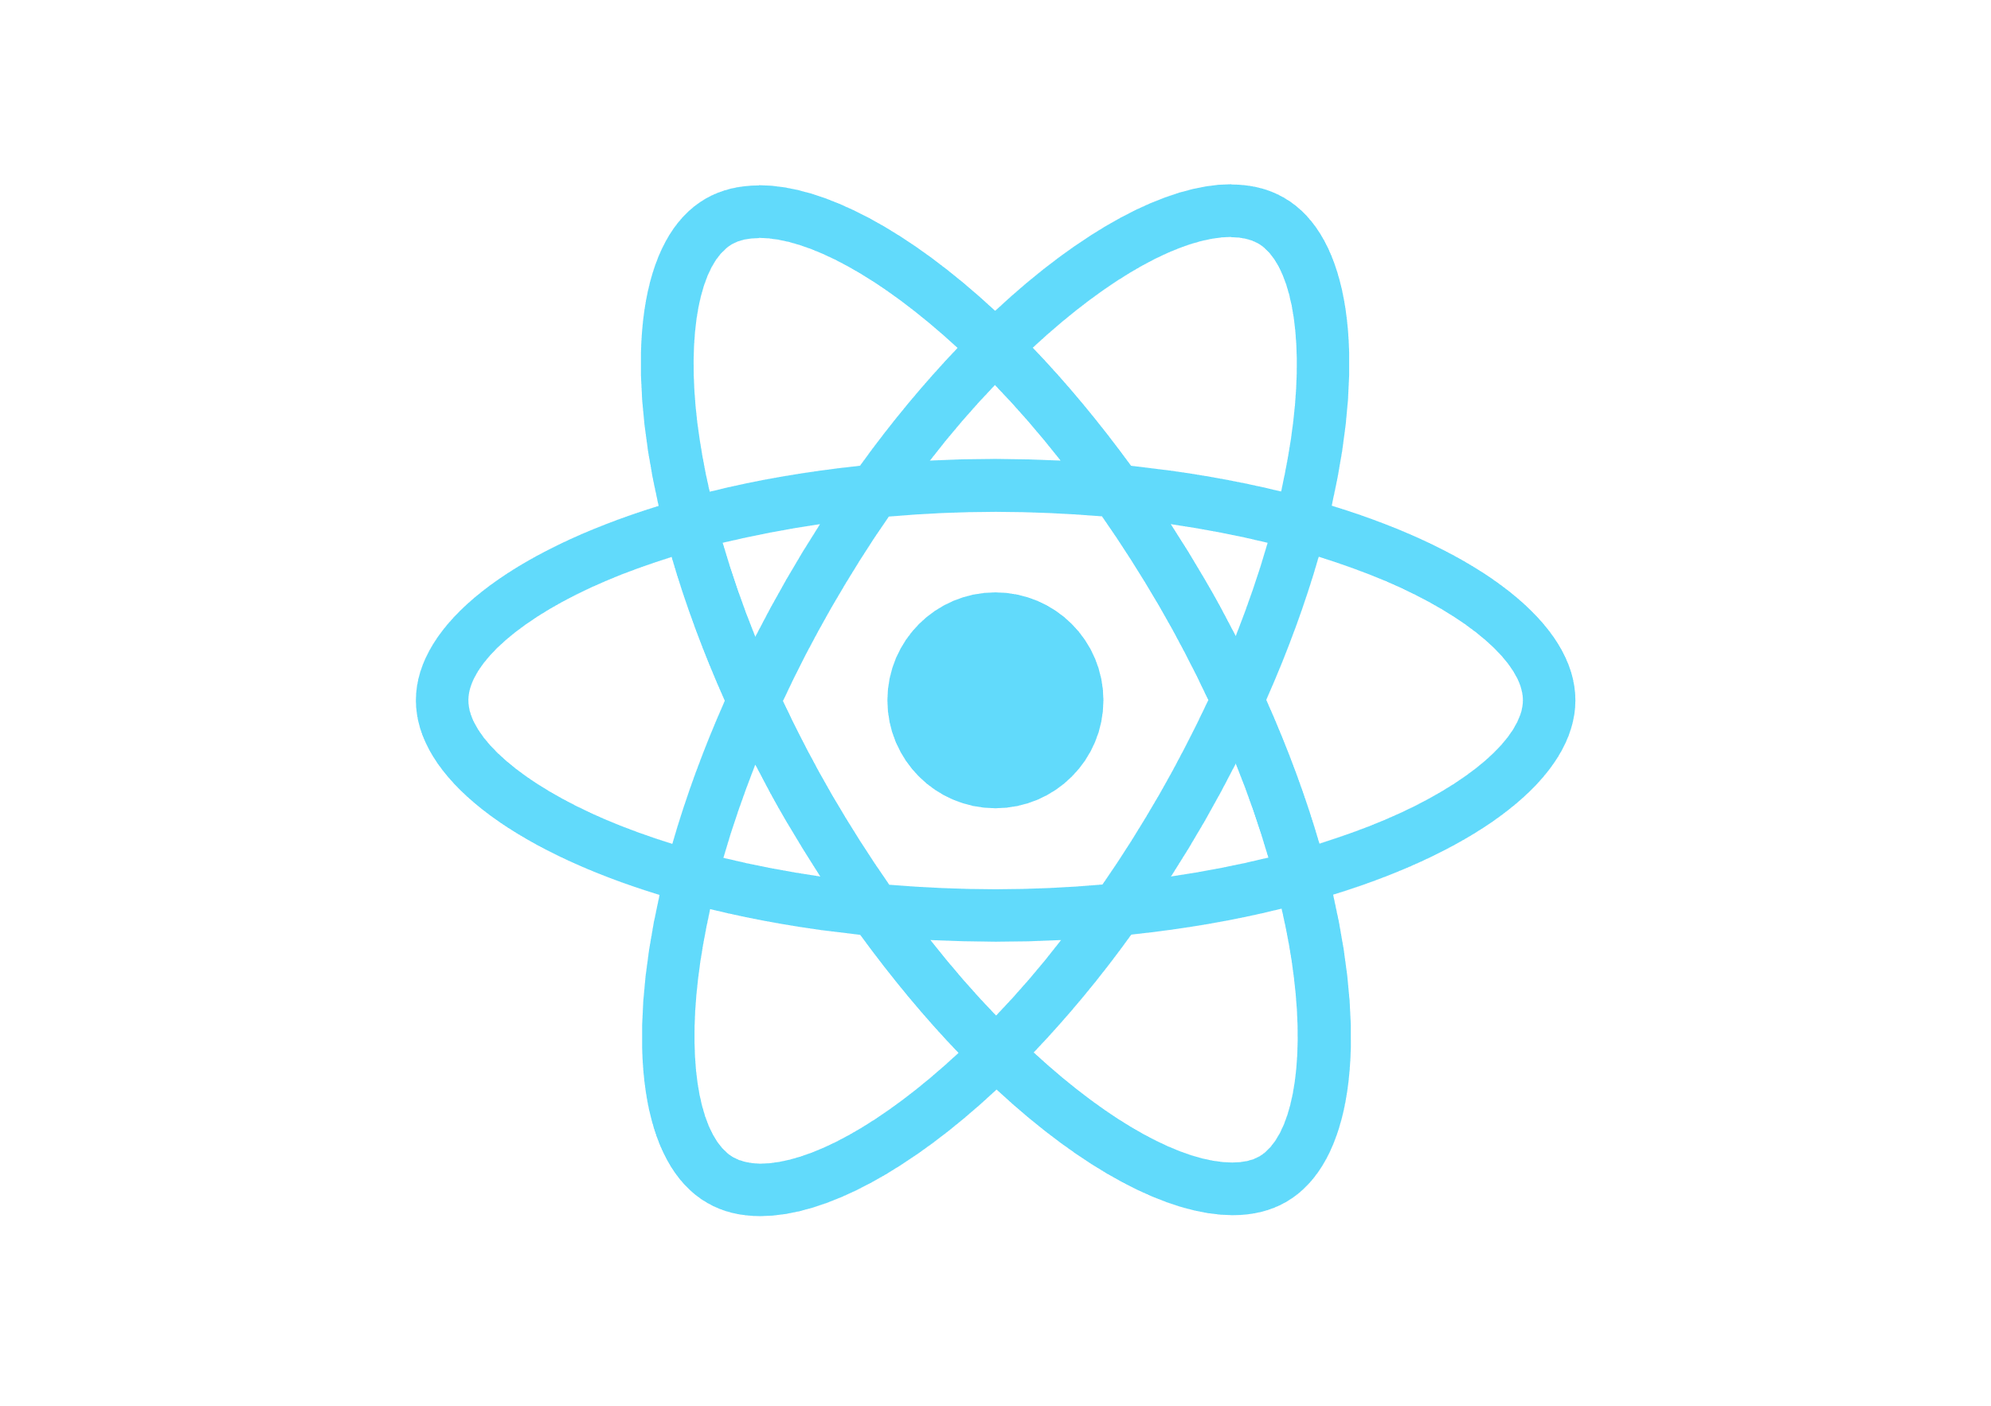


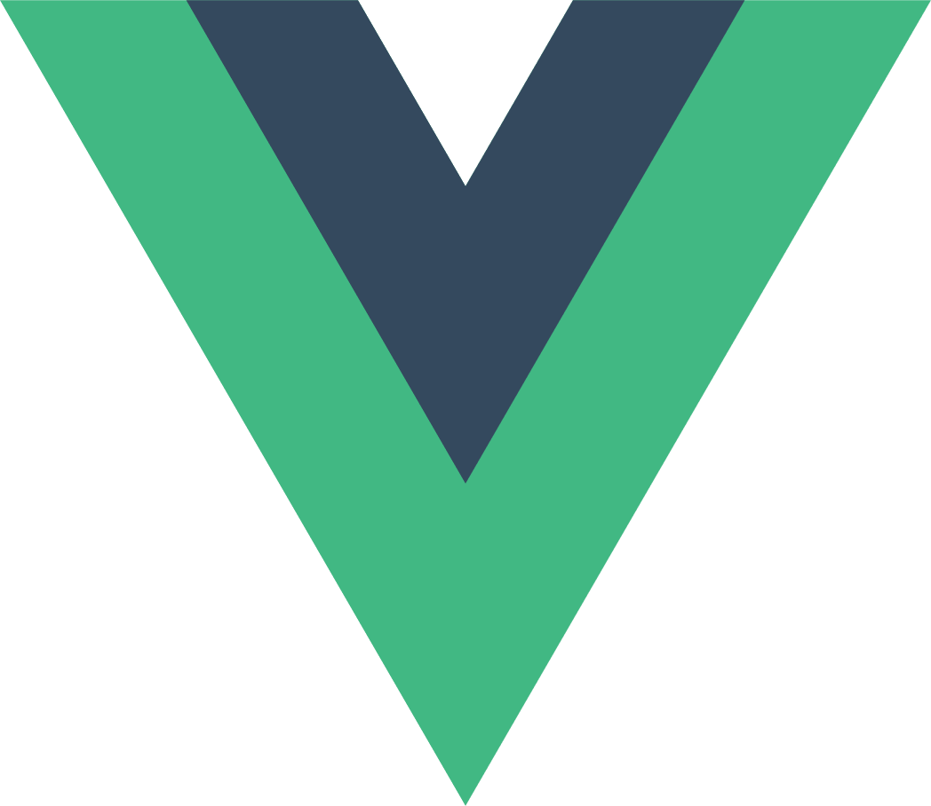
Static web apps
Static web apps are commonly built using libraries and frameworks like Angular, React, Svelte, Vue, or Blazor where server side rendering is not required.
Database
API
Application
Solution
Summary
Notes:
Davide to explain

Slide 85

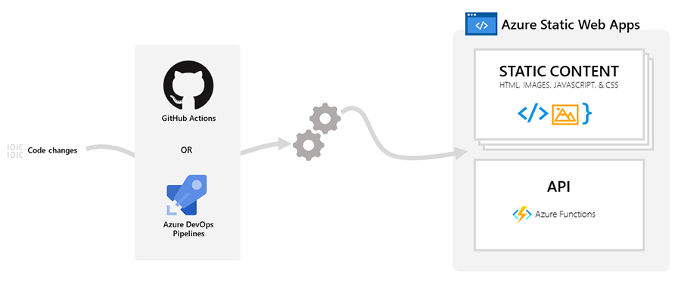
Azure Static Web Apps
+
Combine the power of static web apps with Azure Functions
Database
API
Application
Solution
Summary
Notes:
Davide to start by talking about how Azure Static Web Apps combines static web application hosting and Azure Functions
Davide to ask Anna if there’s support for GitHub automation like we’ve seen with Azure Functions and Azure SQL Database?
Anna to answer and explain how it works with diagram.

Slide 86

GitHub Actions and Azure Static Web Apps
yaml
- name: Build And Deploy
id: builddeploy
uses: Azure/static-web-apps-deploy@v0.0.1-preview
with:
azure_static_web_apps_api_token: ${{ secrets.AZURE_STATIC_WEB_APPS_API_TOKEN }}
repo_token: ${{ secrets.GITHUB_TOKEN }}
action: "upload"
app_location: "azure-static-web-app/client"
api_location: "azure-static-web-app/api"
output_location: ".github/workflows"
Database
API
Application
Solution
Summary
Notes:
Anna

Slide 87
Knowledge check
Notes:
Anna to lead and then ask Davide what he thinks the answer is (D)

Slide 88
Question 2
What is the main value proposition of Azure Static Web Apps?
Scalable cloud service for web apps that require server-side rendering
Variation of Azure Functions, which supports Angular and React
Combination of Azure Functions and Azure SQL Database
Combination of static web apps and serverless APIs
Notes:
Anna to lead and then ask Davide what he thinks the answer is (D)
Explanation: That's correct! Azure Static Web Apps is a combination of a static web app and Azure Functions.

Slide 89
Question 2
What is the main value proposition of Azure Static Web Apps?
Scalable cloud service for web apps that require server-side rendering
Variation of Azure Functions, which supports Angular and React
Combination of Azure Functions and Azure SQL Database
Combination of static web apps and serverless APIs
Notes:
Anna to lead and then ask Davide what he thinks the answer is (D)
Explanation: That's correct! Azure Static Web Apps is a combination of a static web app and Azure Functions.

Slide 90
Question 3
What information is contained in the GitHub workflow file for an Azure Static Web App?
App location and API location in the repository
App location, API location, and secrets stored in plain text
App location, API location, and references to secrets
App location, API location, and subscription ID
Notes:
Anna to lead and then ask Davide what the answer is ©
Explanation: Correct! Secrets are stored in the repository, but not in plain text in the workflow file.

Slide 91
Question 3
What information is contained in the GitHub workflow file for an Azure Static Web App?
App location and API location in the repository
App location, API location, and secrets stored in plain text
App location, API location, and references to secrets
App location, API location, and subscription ID
Notes:
Anna to lead and then ask Davide what the answer is ©
Explanation: Correct! Secrets are stored in the repository, but not in plain text in the workflow file.

Slide 92
Demo
Deploy an Azure Static Web App
Notes:
Anna to show in portal but also flash up that you can do it with commands

Slide 93
Deploy an Azure Static Web App
Deploy an Azure Static Web App
Notes:
Anna to show in portal but also flash up that you can do it with commands

Slide 94
Accessing data from Azure Static Web Apps

Slide 95
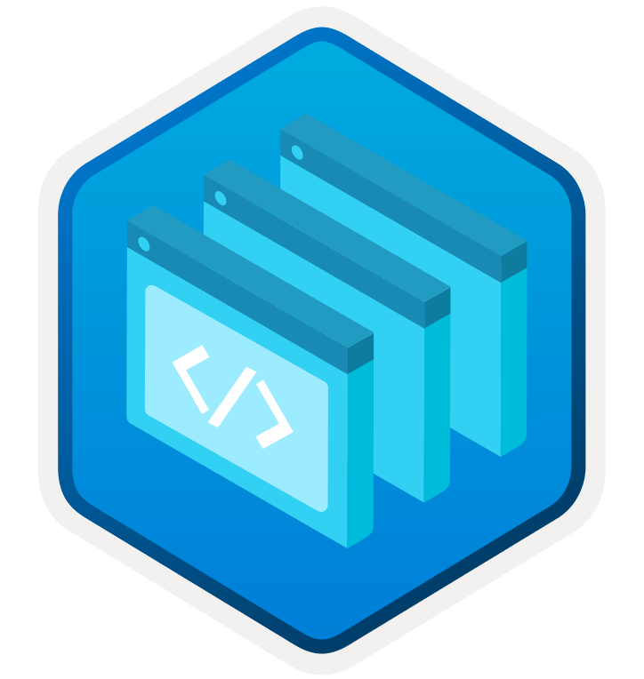
Accessing data from Azure Static Web Apps
Often, a database is required to obtain, process, and serve data related to the application.
Client UI
Backend API
Azure SQL
JSON
JSON
JSON
JSON
Client UI
Backend API
Azure SQL
Database
API
Application
Solution
Summary
Notes:
Anna to start to explain but then ask David how it works for Azure SQL for the front end?

Slide 96
Access data for the front end
The front end, a static web page, has been created with a popular framework Vue.js.
javascript
$.getJSON(apiUrl, function (data) {
plotWKT(data);
});
const params = new URLSearchParams(location.search);
const rid = params.get('rid');
const gid = params.get('gid');
const apiUrl = `/api/bus-data?rid=${rid}&gid=${gid}`;
Database
API
Application
Solution
Summary
Notes:
NOTE THIS ANIMATES, two code blocks!
Davide

Slide 97
javascript
javascript
function plotWKT(data) {
var f1, f2;
if (data.busData == [] || data.geoFence == [])
return;
try {
f1 = format.readFeature(data.geoFence);
f2 = format.readFeature(data.busData);
} catch (err) { }
features.clear();
// geoFence
if (f1)
{
f1.getGeometry().transform('EPSG:4326', 'EPSG:3857’);
features.push(f1);
}
// busData
if (f2)
{
f2.getGeometry().transform('EPSG:4326', 'EPSG:3857’);
features.push(f2);
}
...
Notes:
The front end, a static web page, has been created with a popular framework Vue.js. It's a simple application with goals to display a map, real-time bus data points, and geofence(s).
[!NOTE] The code created was inspired by https://github.com/clydedacruz/openstreetmap-wkt-playground
In this application, an important part is getting the route ID and geofence ID parameters that will be passed through the URL via the rid and gid URL parameters.
const params = new URLSearchParams(location.search); const rid = params.get('rid'); const gid = params.get('gid'); const apiUrl = `/api/bus-data?rid=${rid}&gid=${gid}`;
After that, it's easy to call the apiUrl that calls the Azure Function that fetches the corresponding bus and geofence data from Azure SQL Database to be displayed in real time.
$.getJSON(apiUrl, function (data) { plotWKT(data); }); }
Once the data is returned in Well-Known Text (WKT) format, the function plotWKT simply gathers data.geoFence and data.busData and plots them accordingly. Part of that function is shown below.
function plotWKT(data) { var f1, f2; if (data.busData == [] || data.geoFence == []) return; try { f1 = format.readFeature(data.geoFence); f2 = format.readFeature(data.busData); } catch (err) { } features.clear(); // geoFence if (f1) { f1.getGeometry().transform('EPSG:4326', 'EPSG:3857'); features.push(f1); } // busData if (f2) { f2.getGeometry().transform('EPSG:4326', 'EPSG:3857'); features.push(f2); } ...

Slide 98

Access Azure SQL Database for the back end
The front end essentially calls the API to return all the necessary data.
Client UI
Backend API
Azure SQL
JSON
JSON
JSON
JSON
Client UI
Backend API
Azure SQL
Database
API
Application
Solution
Summary
Notes:
Anna.
At the end, to ask Davide: Davide, we built this sample using several different languages. Can you tell folks some of the things to consider when connecting to Azure SQL Database from applications?

Slide 99
Create a connection to Azure SQL Database
.NET → Microsoft.Data.SqlClient
Python → pyodbc
Node.js → mssql
C#
Server=tcp:[serverName].database.windows.net,1433;Database=bus-db;User ID=[userId];Password=[yourPassword];Encrypt=true;Connection Timeout=30;
Python
Driver={ODBC Driver 17 for SQL Server};Server=[serverName].database.windows.net,1433; Database=bus-db;UID=[userId];PWD=[yourPassword];Connection Timeout=30;
Node.js
mssql://[userId]:[yourPassword]@[serverName].database.windows.net/bus-db?encrypt=true
Database
API
Application
Solution
Summary
Notes:
Davide to explain and share any tips and tricks about the libraries or connecting

Slide 100
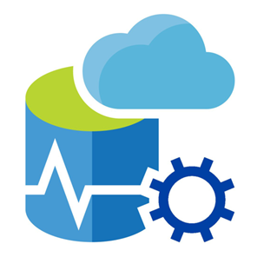
Return the real-time bus data to the application
The stored procedure web.GetMonitoredBusData returns the real-time bus data in JSON format
This way is super easy to consume it!
{
“busData”: “MULTIPOINT ((-122.143341 47.661), … (-122.132492 47.617))”
“geoFence”: “POLYGON ((-122.14359028995352 47.618245191, … , -122.14359028995352 47.618245191))”
}
Database
API
Application
Solution
Summary
Notes:
Anna: Cool thanks Davide. Yeah and once you’re connected it’s really just a matter of calling the stored procedure that returns the data to surface in the app!

Slide 101
Knowledge check
Notes:
Anna to lead and then ask Davide what he thinks the answer is

Slide 102
Question 4
What do the rid and gid parameters represent?
rid and gid represent the specific route and geofence to be displayed on the map
rid and gid represent the specific route and group of buses to be displayed on the map
rid and gid represent all the routes and geofences
rid and gid represent all the routes and groups of buses
Notes:
Anna to lead and then ask Davide what he thinks the answer is

Slide 103
Question 4
What do the rid and gid parameters represent?
rid and gid represent the specific route and geofence to be displayed on the map
rid and gid represent the specific route and group of buses to be displayed on the map
rid and gid represent all the routes and geofences
rid and gid represent all the routes and groups of buses
Notes:
Anna to lead and then ask Davide what he thinks the answer is

Slide 104
Question 5
What is the order of serving data to the front end?
The client application obtains the parameters and passes them to Azure SQL Database, which returns the relevant data to the Azure Function.
The Azure Function obtains the parameters and passes them to the client application, then the client application gets the relevant data from Azure SQL Database and displays it in the client application.
The client application obtains the parameters and passes them to the Azure Function, then the Azure Function gets the relevant data from Azure SQL Database and returns it to the client application.
Azure SQL Database obtains the parameters and passes them to the Azure Function, then the Azure Function gets the relevant data from the client application and returns it to Azure SQL Database.
Notes:
Anna to lead and then ask Davide what he thinks the answer is

Slide 105
Question 5
What is the order of serving data to the front end?
The client application obtains the parameters and passes them to Azure SQL Database, which returns the relevant data to the Azure Function.
The Azure Function obtains the parameters and passes them to the client application, then the client application gets the relevant data from Azure SQL Database and displays it in the client application.
The client application obtains the parameters and passes them to the Azure Function, then the Azure Function gets the relevant data from Azure SQL Database and returns it to the client application.
Azure SQL Database obtains the parameters and passes them to the Azure Function, then the Azure Function gets the relevant data from the client application and returns it to Azure SQL Database.
Notes:
Anna to lead and then ask Davide what he thinks the answer is

Slide 106
Solution architecture
Database
API
Application
Solution
Summary
Notes:
Davide to review the entire architecture’s solution
Let's review a possible architecture that would support the challenges and goals discussed.
The architecture uses several different services to minimize the amount of code you need to write, and to take advantage of the scalability and infrastructure benefits provided by Azure.

Slide 107
Demo
Configure Azure Static Web Apps and monitor the solution
Notes:
Anna to revisit application (configure azure sql connection strings) and show final solution
Then review github actions

Slide 108
Configure Azure Static Web Apps and monitor the solution
Configure application settings
View the published bus-app
Review the GitHub Action runs
Notes:
Anna to revisit application (configure azure sql connection strings) and show Davide final solution
Then review github actions
Anna to Review what we did then ask Davide: Davide, we’ve seen a lot of services but I think we can finally put together the solution. Can you take us through it?

Slide 109
Exercise! Deploy the end-to-end solution
Deploy the resources
Use GitHub Actions for CI/CD
Witness the solution in action
Module 4: aka.ms/azuremodernapps04
Units 3 and 5
Notes:
1:30 PM
Anna to revisit application (configure azure sql connection strings) and show Davide final solution
Then review github actions
Anna to Review what we did then ask Davide: Davide, we’ve seen a lot of services but I think we can finally put together the solution. Can you take us through it?

Slide 110
Summary
Notes:
2:05

Slide 111
Summary
In the language of your choice (Node.js, Python, or .NET), we used an Azure Function that's built-in to an Azure Static Web App to get the data for specific bus routes and geofences. The Azure Static Web App was then used to surface the map on a website.
You learned how to design APIs in any language and integrate them with Azure SQL Database and Azure Static Web Apps
You learned how to create Vue.js web applications using Azure Static Web Apps
You also learned how Visual Studio Code, the Azure portal, and GitHub are integrated to give you an efficient and seamless way to maintain CI/CD with GitHub Actions.
Database
API
Application
Solution
Summary
Notes:
Anna

Slide 112
Resources
Twitter: @AnalyticAnna
LinkedIn: amthomas46
Try the whole learning path https://aka.ms/AzureModernApps
Watch our show https://aka.ms/azuresqlyt
Follow us on twitter to stay up to date @AzureSQL
We wrote a book! https://aka.ms/azuresqlfordevelopers
Database
API
Application
Solution
Summary
Notes:
Anna but to end by asking Davide about the book

Slide 113
60 min break
See you back here soon!
Notes:
Should be around 2:15-2:30

Slide 114
Part 3: Closing keynote
Sanjay Mishra
Principal Group Program Manager
Microsoft
@SQLCATalyst
Notes:
2:30
Anna, but also to ask Silvano to introduce himself, and also to ask Silvano why we created this module
Link to published module on Learn: https://docs.microsoft.com/en-us/learn/modules/learn-pr/azure/deploy-iot-solution-azure-sql-database/
Schedule for 60 min session:
Intro and overview: 7 min
Intro and architecture: 15 min
Exercise 1: 10 min
Optimize and process: 15 min
Exercise 2: 5 min
Putting it all together: 8 min

Slide 115
IOT @Millions

Slide 116

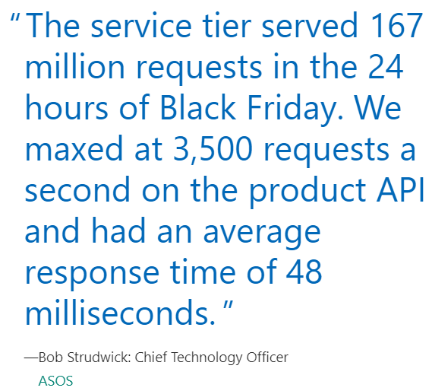
Customer Stories
ASOS is leading online fashion retailer. This rapidly growing company with over 15.4 million customers has also accelerated development of innovative mobile apps and features to quickly target new markets and stay on top of consumer and technology trends.

Slide 117

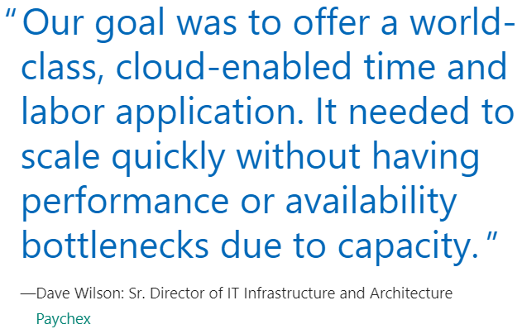
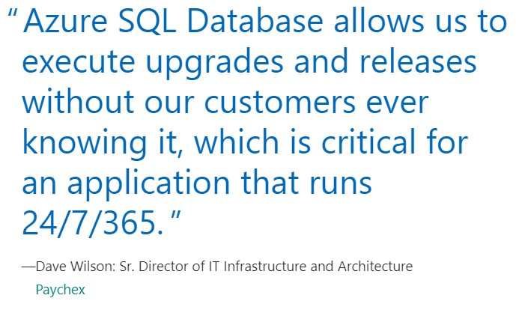
Customer Stories
When it comes to business-critical apps, few are more important than time tracking and payroll. Paychex handles these services for millions of hourly workers across two continents. By migrating their on-premises environment to the cloud and utilizing elastic pools in Azure SQL Database, Paychex was able to optimize costs, ensure availability for their customers, and scale elastically to meet any demand

Slide 118
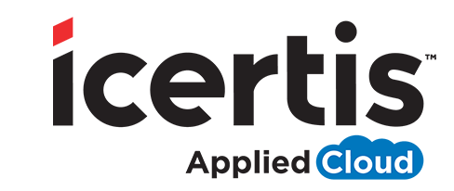
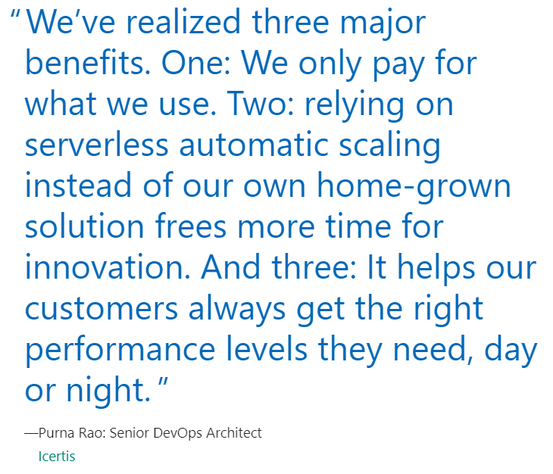
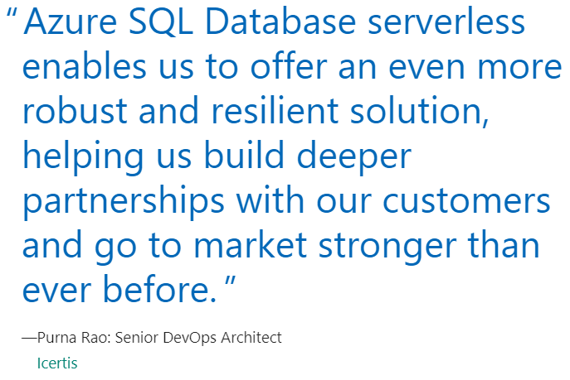
Customer Stories
Icertis solves the hardest contract management problems for some of the world’s biggest organizations. By moving to the Microsoft Azure SQL Database serverless compute tier, Icertis can now rely on automatic, near-instant rescaling of database compute resources to immediately accommodate its customers’ changing and often unpredictable workload patterns. In making the move, the company cut its database costs by nearly 70 percent.

Slide 119

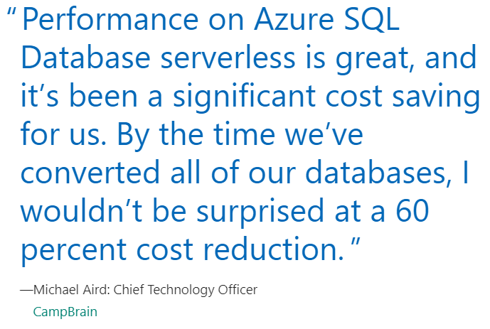
Customer Stories
CampBrain provides a gateway to fun for millions of campers. Based in Toronto, Canada, the software company offers a system to run camp registration, fee collection, and other administrative tasks. The small company serves a diverse clientele subject to dramatic and unpredictable usage spikes.

Slide 120



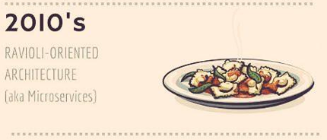
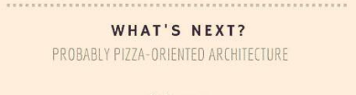
?
Images by @benorama

Slide 121
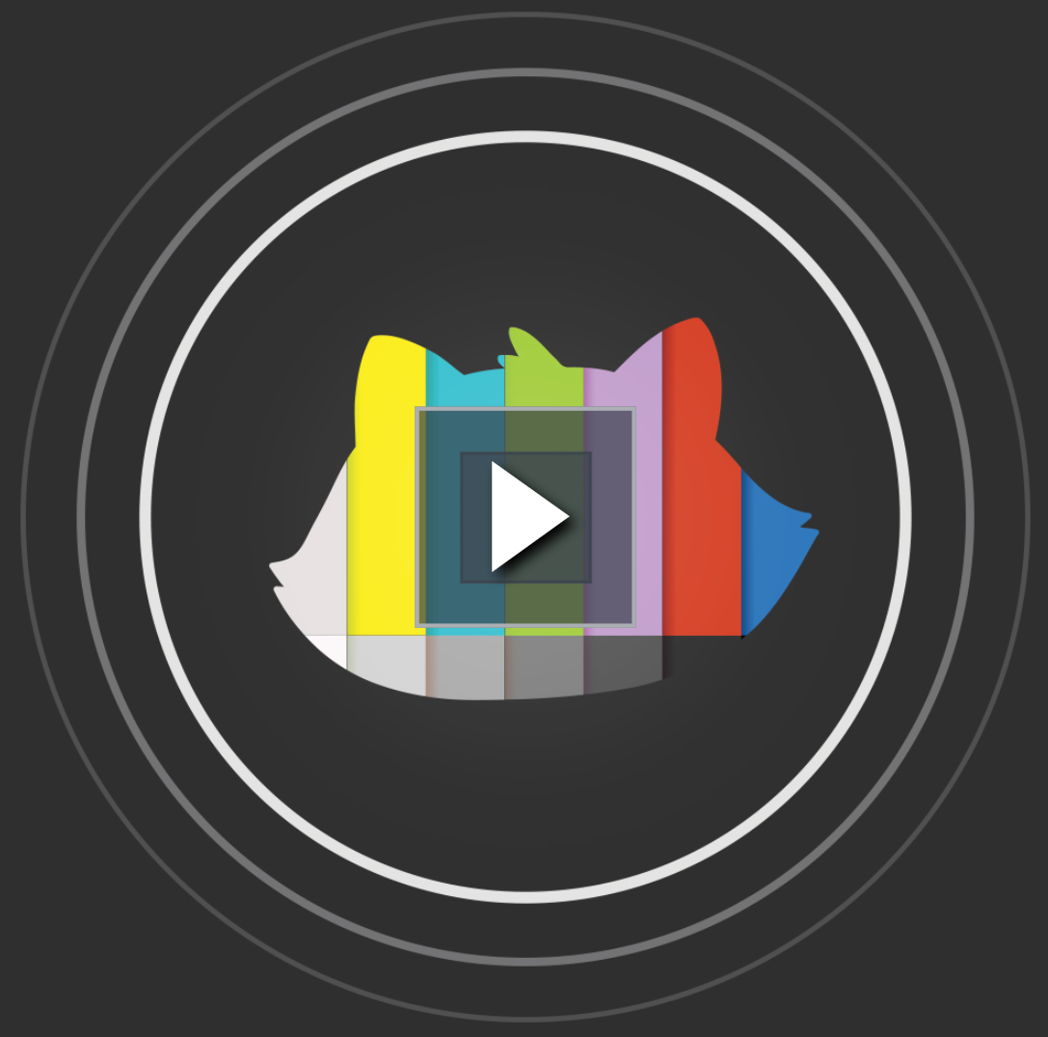

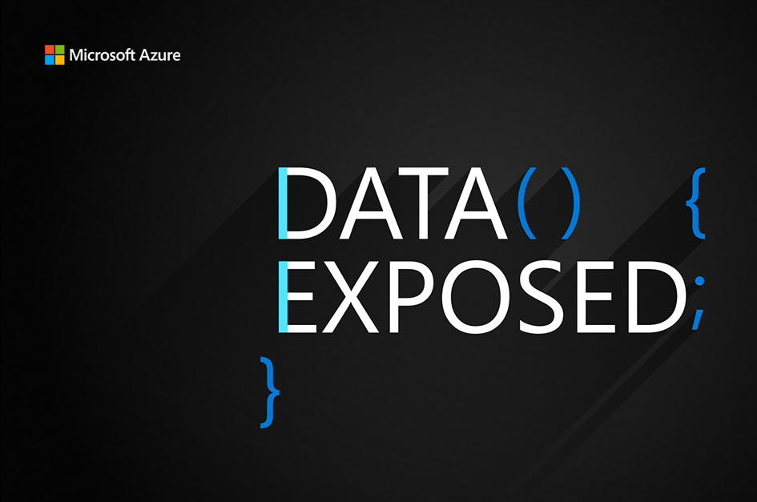
Join us weekly on Learn TV.
https://aka.ms/azuresqlyt
Notes:
Anna to present this one and then Davide to wrap by thanking attendees and telling them to enjoy the rest of Microsoft Build
Again thank you all for joining us today at these Learn Live at Build Sessions.
But as they say, "that's not all".
If you enjoyed this session today, we hope you come back for Learn Live every week. Each episode will cover a Learn Module and work with experts to cover the Learn content in depth, with live Q & A.
With over 2,000 topics in Microsoft Learn, we will be covering all manner of things going forward.
Learn Live airs every Monday on Learn TV, so mark your calendars, and come join in.

Slide 122
End slide

Slide 123
Deploy IoT solutions with Azure SQL Database
Speaker Name
aka.ms/azuresqliot
Title
Speaker Name
Title
Notes:
Link to published module on Learn: https://docs.microsoft.com/en-us/learn/modules/learn-pr/azure/deploy-iot-solution-azure-sql-database/

